Slide 1
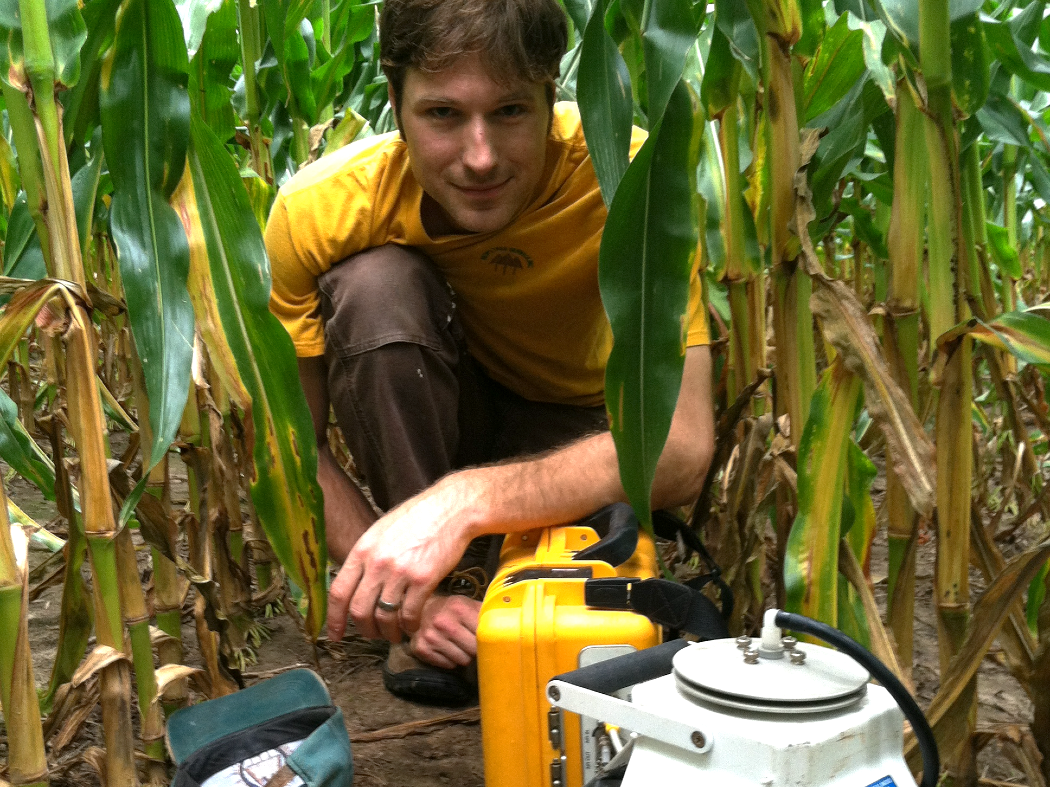
Plant root contributions to the carbon balance of a changing Midwest
Christopher K Black
PhD Defense
October 31, 2016

Slide 2
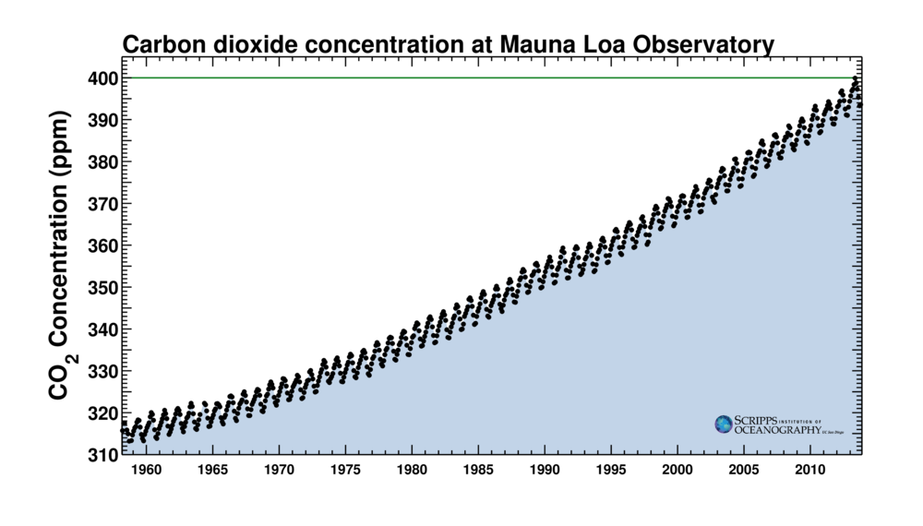
Notes:
Atmospheric CO2 is rising and it’s our fault.
Whole atmosphere contains about 800 Pg C, Human activity adds about 4 more each year
National Climate Assessment predicts temperature of Midwest will rise 2-4 °C by midcentury
This will produce major shifts in the ecology and biogeochemistry of Midwestern ecosystems
And therefore on the policies and land use decisions needed to manage them effectively.

Slide 3
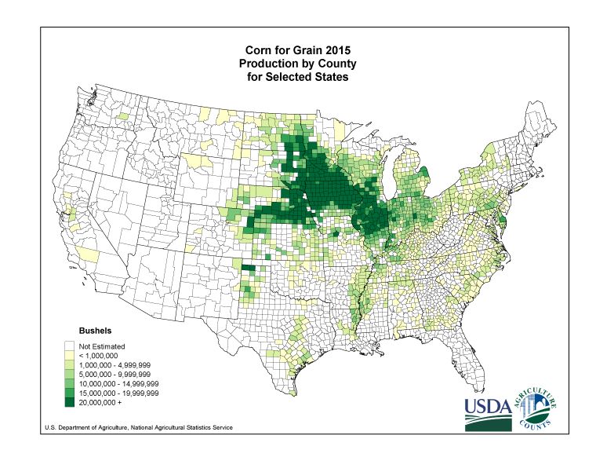
[agroecosystems->importance of soil C -> importance of roots]
Notes:
Maize and soybean: 71.3 million hectares planted this year (roughly Illinois times five)
Largest ecosystem type in the continental US
Mostly in private ownership -> MANY individual decisions happening as climate changes!
I’m especially interested in how these decisions change C storage – in other words, will the Midwest’s response amplify or reduce global climate change?

Slide 4
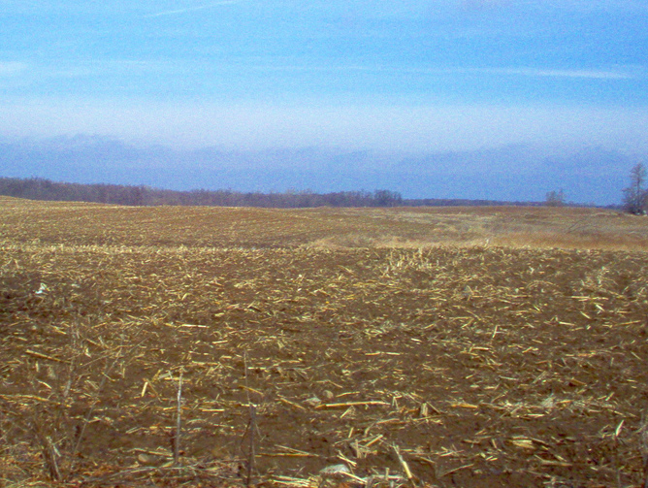
CC-licensed photo by Flickr user ‘~windys~’
Notes:
A distinguishing characteristic of agroecosystems: Harvested every year -- No aboveground C storage
This means their overall C balance depends very heavily on soil C and root inputs.
Recall that CO2 concentration increase comes from from adding 4 Pg C per year to the 800 in the atmosphere
For comparison, there are about 2800 Pg C in soils worldwide, and about 10% of that is in US agricultural land.

Slide 5
Central question:
In a warmer, higher-CO2 Midwest,
how will the mass, placement, and chemical & taxonomic makeup of roots
affect the trajectory of belowground C storage?
CC-licensed photo by Flickr user ‘~windys~’

Slide 6
Central question:
In a warmer, higher-CO2 Midwest,
how will the mass, placement, and chemical & taxonomic makeup of roots
affect the trajectory of belowground C storage?
Three facets of belowground C storage:
Projections of business as usual: Environmental controls on C loss rates
High-yield perennial grasses: Where is C input placed?
Low-input high-diversity prairie restoration: Who is placing the C?
CC-licensed photo by Flickr user ‘~windys~’
Notes:
40% of US maize production goes to make ethanol for fuel
Attractive alternate land use: Growing other, hopefully more sustainable crops for ethanol

Slide 7
Central question:
In a warmer, higher-CO2 Midwest,
how will the mass, placement, and chemical & taxonomic makeup of roots
affect the trajectory of belowground C storage?
Three facets of belowground C storage:
Projections of business as usual: Environmental controls on C loss rates
High-yield perennial grasses: Where is C input placed?
Low-input high-diversity prairie restoration: Who is placing the C?
Common challenge:
Measurements are “easy” on small scales too small to matter
Measurements are hard or impossible at the scale of the questions
CC-licensed photo by Flickr user ‘~windys~’

Slide 8
Central question:
In a warmer, higher-CO2 Midwest,
how will the mass, placement, and chemical & taxonomic makeup of roots
affect the trajectory of belowground C storage?
Three facets of belowground C storage:
Projections of business as usual: Environmental controls on C loss rates
High-yield perennial grasses: Where is C input placed?
Low-input high-diversity prairie restoration: Who is placing the C?
Common challenge:
Measurements are “easy” on small scales too small to matter
Measurements are hard or impossible at the scale of the questions
Approach:
Measure what I can, scale up in time and space to match the scale of the question
AKA model-data fusion
…but always with the simplest model I can get away with.
(Sometimes this is still pretty complex)
CC-licensed photo by Flickr user ‘~windys~’

Slide 9
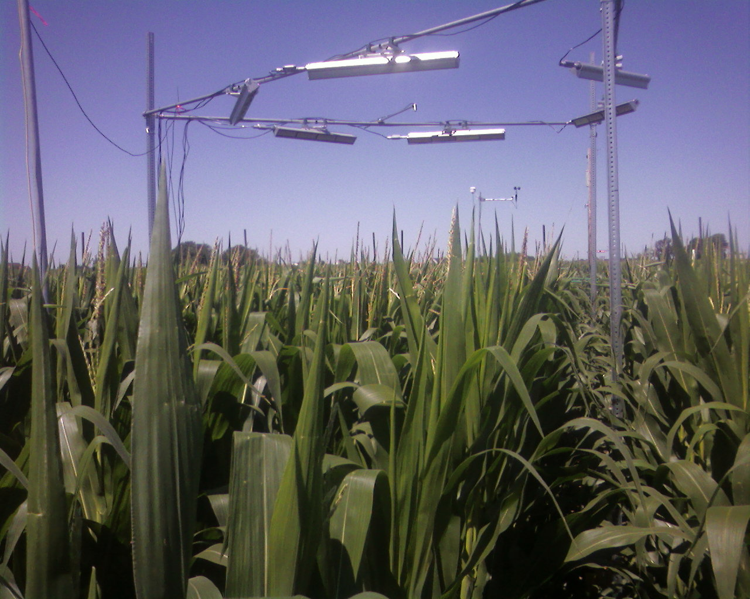
Elevated CO₂ and temperature increase soil C losses from a soybean-maize ecosystem
Christopher K. Black, Sarah C. Davis, Tara W. Hudiburg, Carl J. Bernacchi, Evan H. DeLucia
Global Change Biology, first online 2016
Notes:
For first experiment, I start with a business-as-usual scenario
Maize-soybean tillage continues with conventional tillage as the climate warms and CO2 increases.
What happens to soil C?

Slide 10
Soybean:
eCO₂ → larger plants, larger root systems, more litter inputs
(Gray et al, 2016)
Heat: Little effect
Maize:
Little effect of either heat or CO₂ if not water limited
Ecosystem C inputs will increase as [CO₂] rises.
Outputs?
Notes:
For this project, the root input side of things is relatively well covered.
Soybean plants get larger when grown in high CO2, so both root and litter inputs increase.
Have some really nice evidence for root CO2 effects from Sharon Gray’s work on CO2 + drought.
Heat not published yet, but appears to have no huge differences.
Maize shows little change in total biomass, as long as water is sufficient.
My question: How will these changes affect soil C if continued for decades?
Measure the outputs.

Slide 11
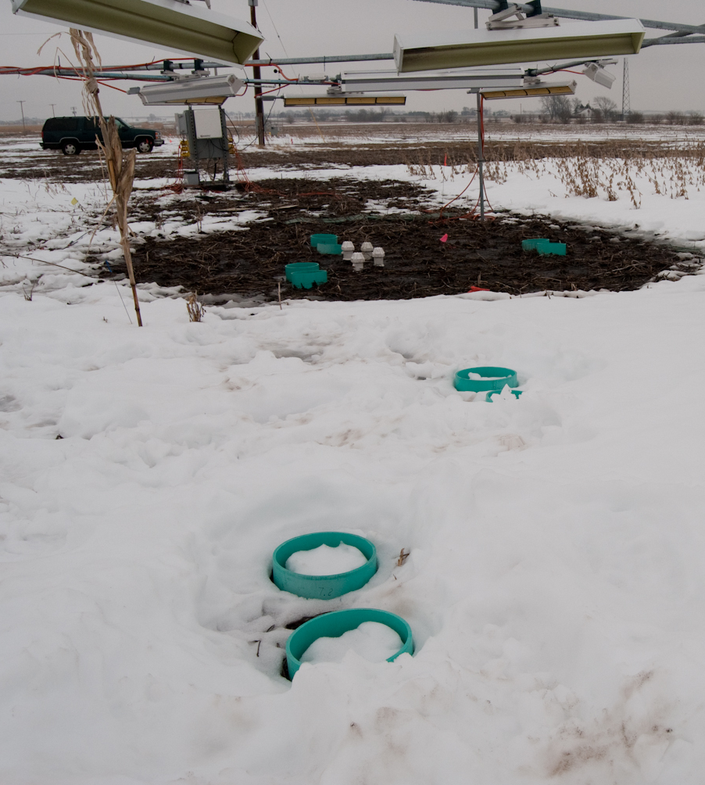
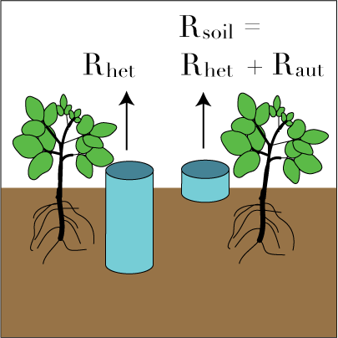
Notes:
Measured soil respiration at T-FACE,
an open-air experiment that imposes elevated CO2 (200 ppm about ambient) and increased temperature (plant canopy 3.5 °C above ambient) in a natural field environment.
Soybean and maize grown in rotation, with tillage and fertilization standard for region.
Shown here: Effect of winter heating. Can see overhead infrared heaters and even, localized temperature treatment.
Also visible: collars used to partition soil respiration into its components:
Deep collars exclude plant roots = heterotrophic respiration = derived from microbial breakdown of SOM
Shallow collars include Rhet and also autotrophic respiration = derived from roots and rhizosphere microbes ➔ find Raut by subtraction.
Think of Rhet as “old” carbon, Raut as “new” carbon. If Rhet increases, probably losing soil C; Raut increasing could just mean “lots of roots respiring while they pump more C into the ground”

Slide 12
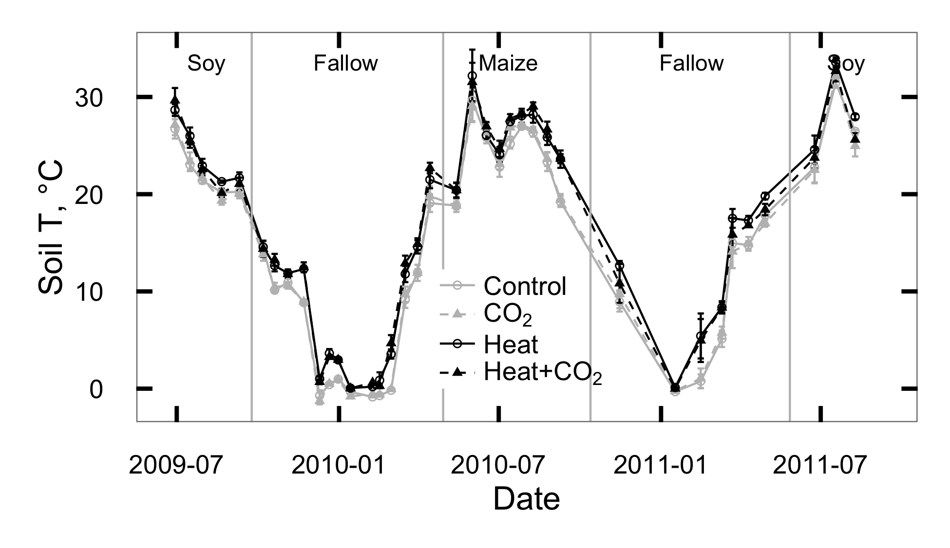
Notes:
Monitored respiration for 3 growing seasons (soybean, maize, soybean) and the winters between
Measurements about every 2 weeks
Color scheme for all graphs: grey = unheated, black=heated, unfilled=ambient CO2, filled=elevated CO2.
Heat treatment worked consistently – soil warmed by almost 2 °C in summer, a bit more in the winter
CO2 did not change soil temperature

Slide 13
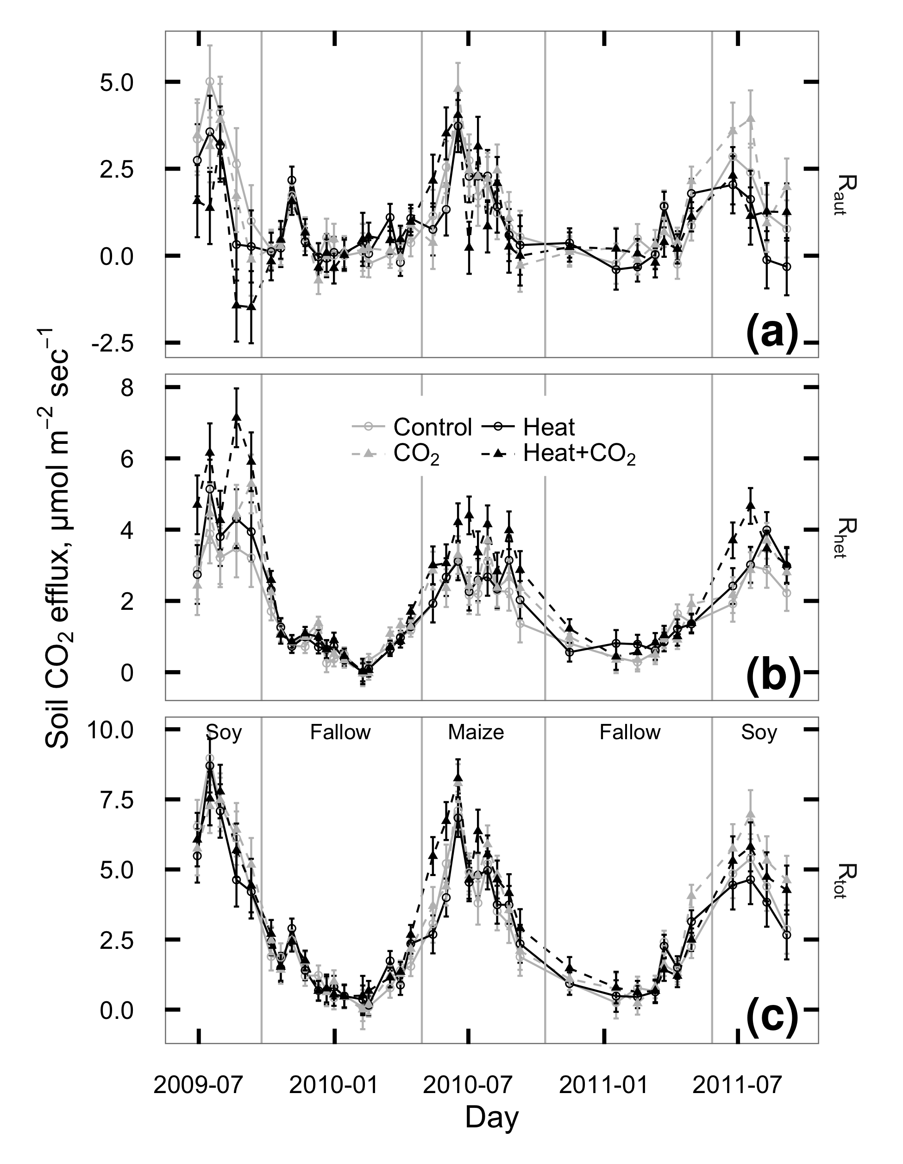
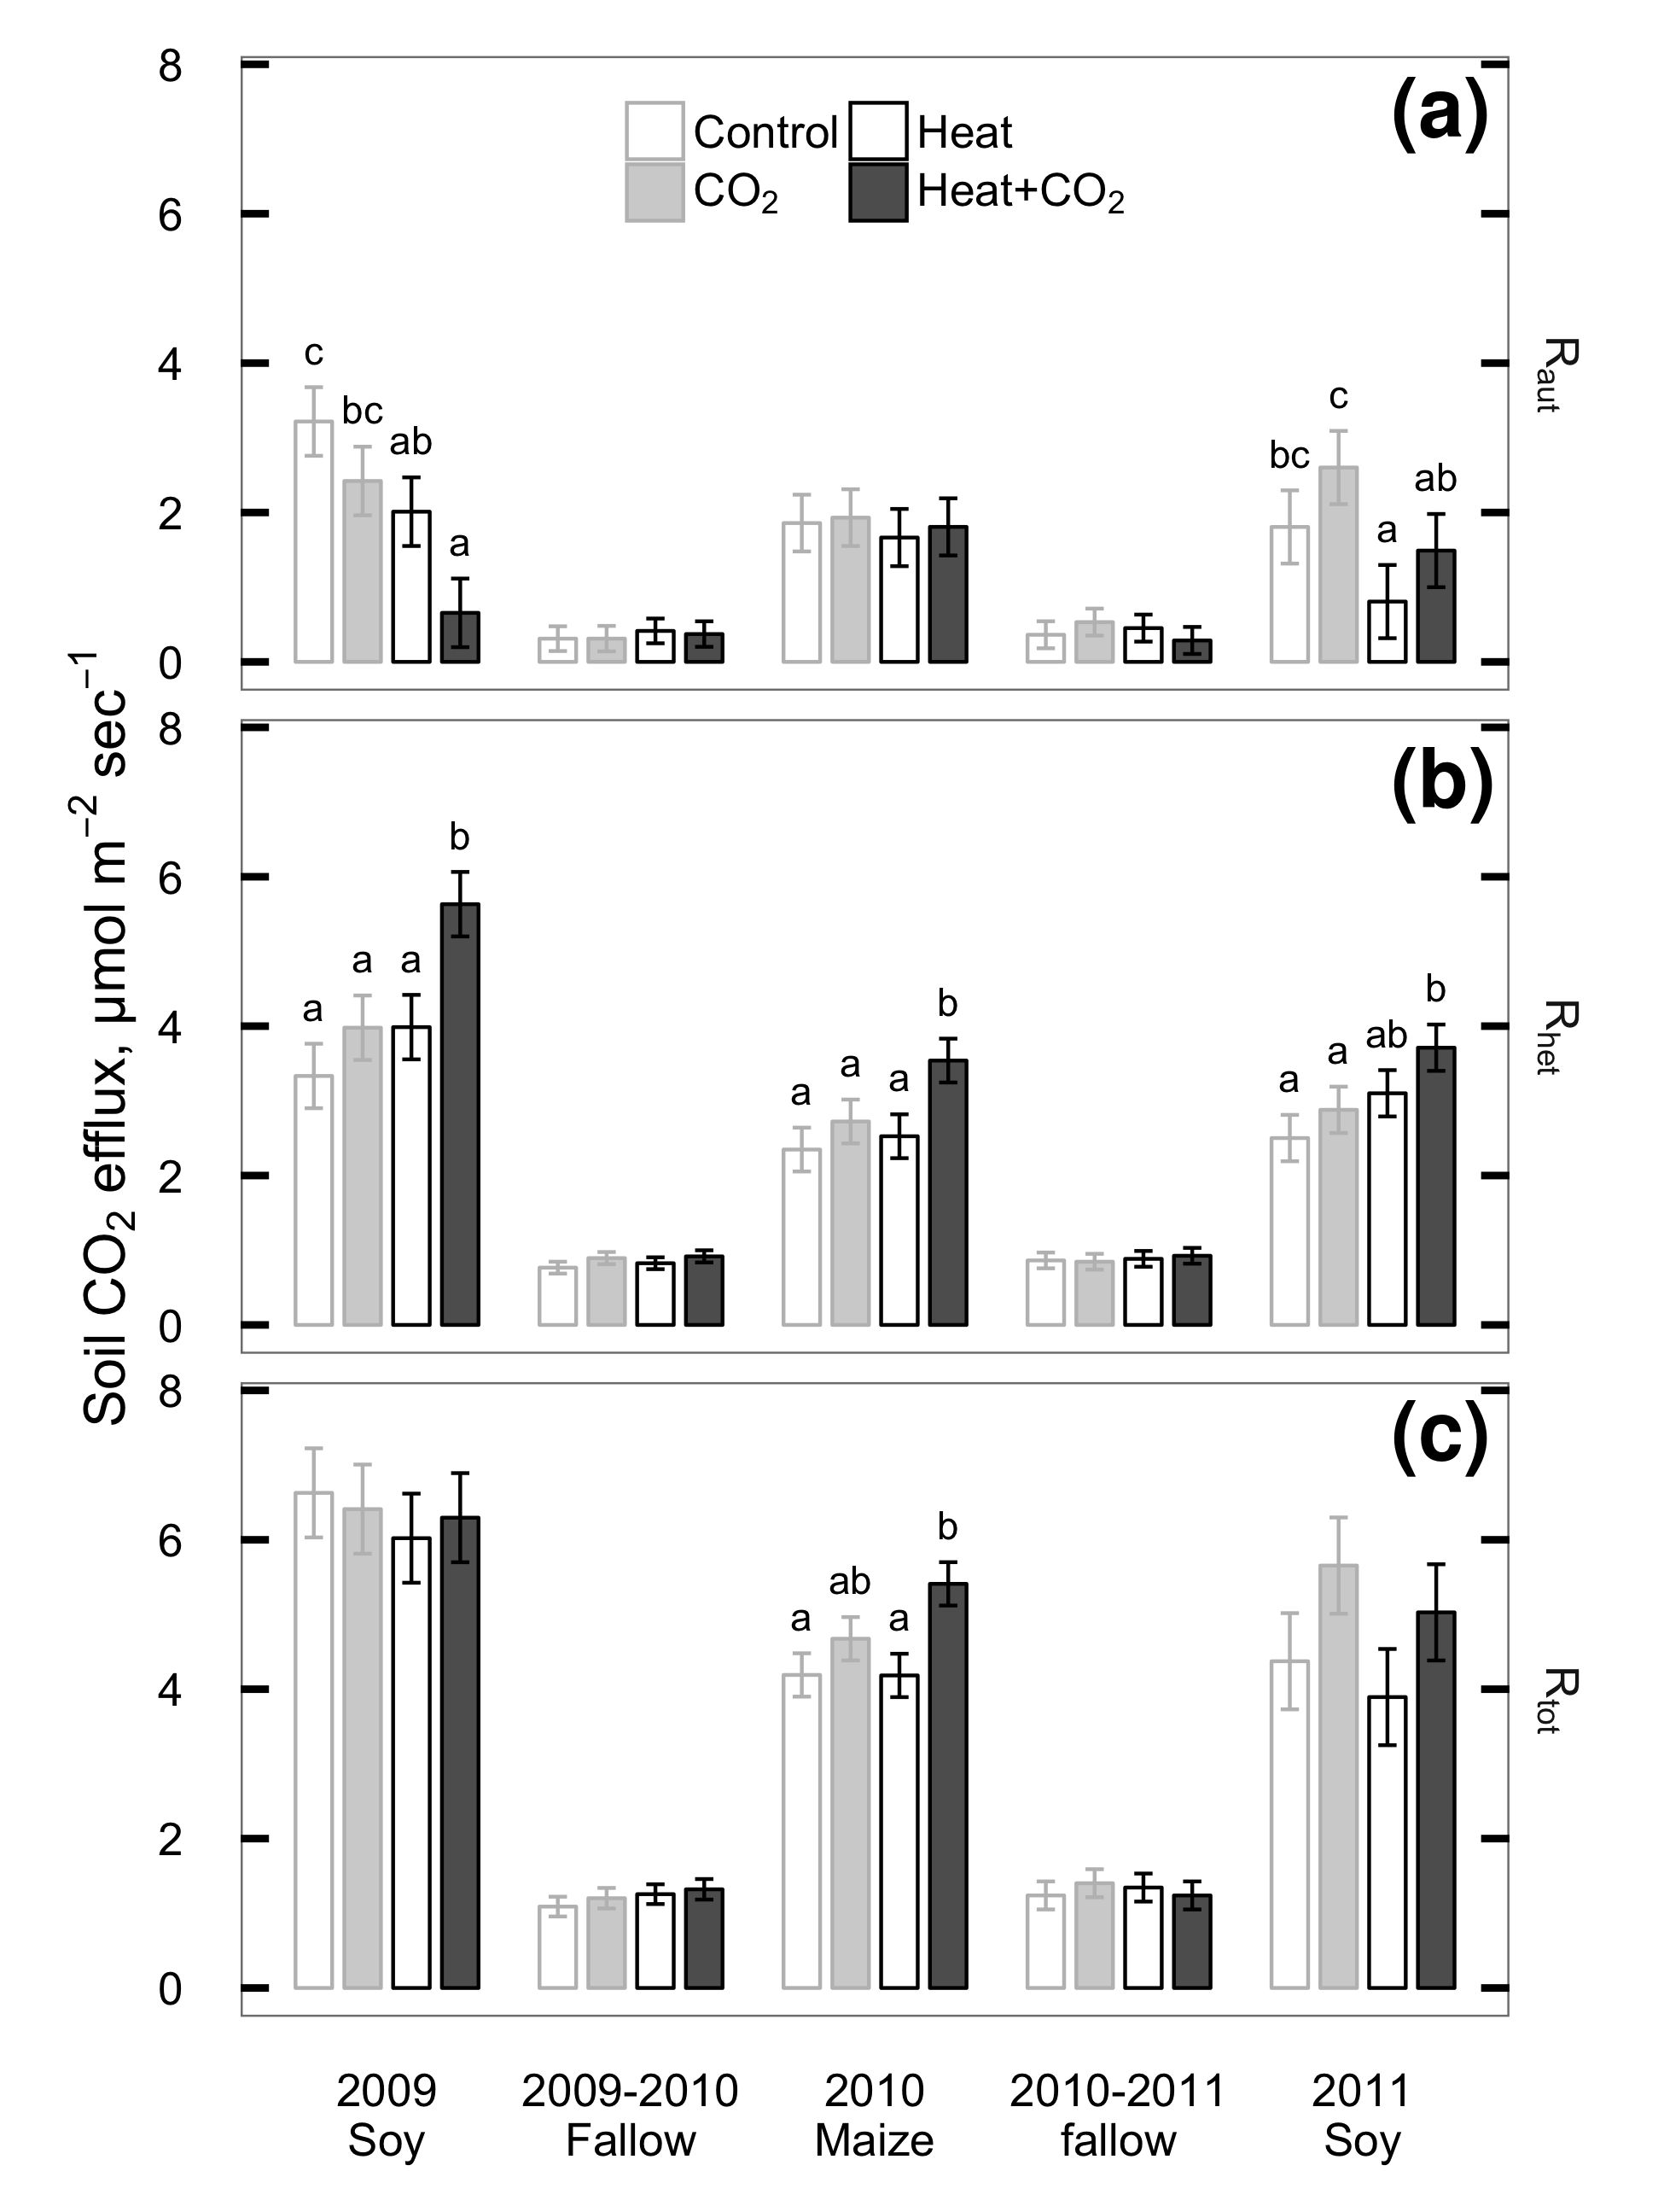
Notes:
Respiration from soy roots reduced by about 20% in heat, 30% in heat+CO2.
No difference in maize
No difference in winter – good! no roots present.

Slide 14
Notes:
Heterotrophic respiration consistently increased by heat and by CO2
Heat +12%, CO2 +16%, heat+CO2 +48%. Effects are additive, no interaction between heat and CO2.
Day x heat x CO2 interaction in 2011, but boils down to different days with significant vs. nonsignificant differences – no change in direction
Winter 2009 (after soy): higher Rhet from eCO2 (probably from litter decomp)
heat higher some days and lower others (probably heat->loss of snow cover-> harder freezing)

Slide 15
Notes:
Whole-soil respiration: Basically no difference!
Across whole experiment, eCO2 +11%, heat+CO2 +13%, heat no CO2 -3%.
Higher Rtot in eCO2 under maize appears to be driven by Rhet.

Slide 16
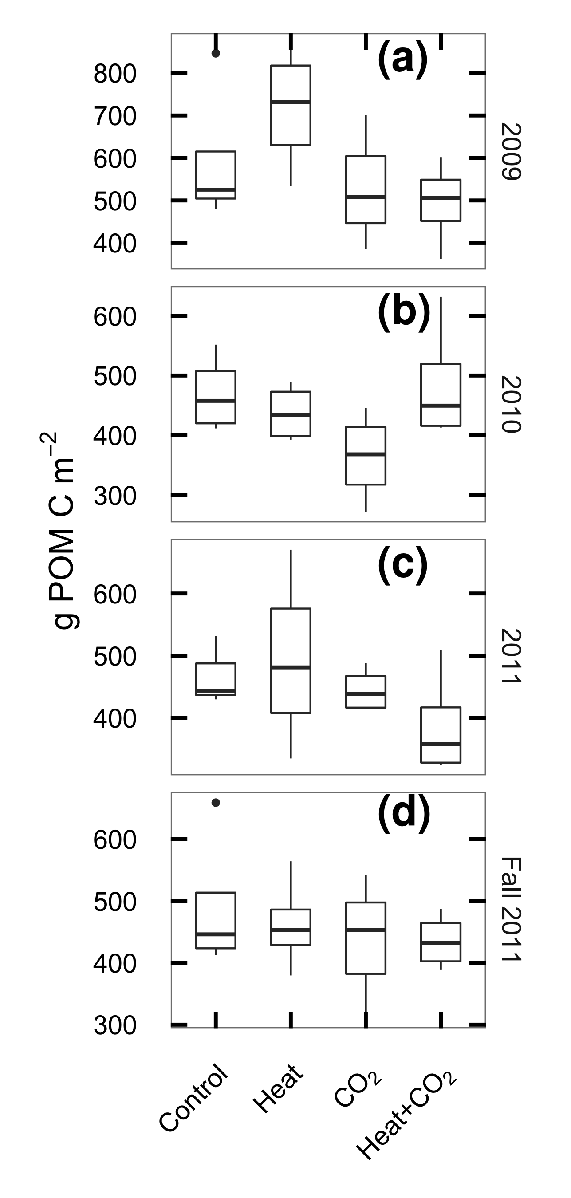
2009
2011
2010
Fall 2011
Notes:
Also measured particulate organic matter
POM = bits of recognizable plant matter in soil
Best proxy for labile soil C, Expect it to be fastest-changing pool.
All treatments declined from beginning to end of experiment, consistently lower in eCO2 than ambient.
Have ten years of eCO2 primed loss of soil C?

Slide 17
Direct measurements suggest:
Heating increases losses from soil organic matter
CO2 increases inputs AND losses
Which will win?
Need to watch for a few decades until the changes become detectable
➔ To the computer!

Slide 18
Direct measurements suggest:
Heating increases losses from soil organic matter
CO2 increases inputs AND losses
Which will win?
Need to watch for a few decades until the changes become detectable
➔ To the computer!
DayCENT:
Well-validated, process-based ecosystem biogeochemistry model
Specify climate, soils, plant growth/chemistry, management
Virtual experiment: What if we kept TFACE running for 100 years?
(NOT a climate change model:
all changes imposed as a step rather than gradually)

Slide 19
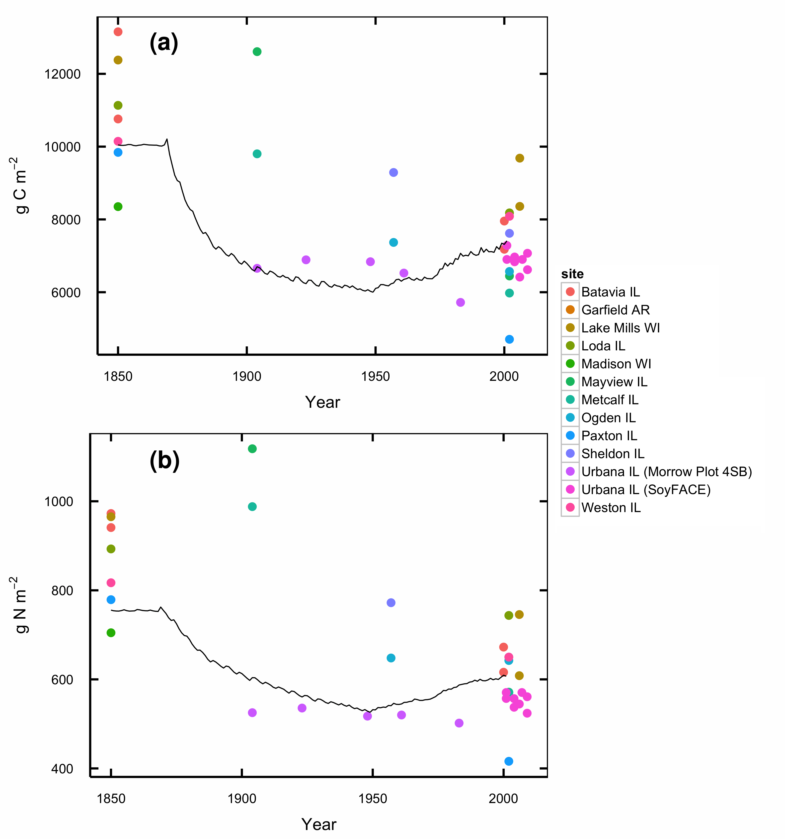
Notes:
Daycent treats soil C as a set of three pools, each with own turnover rate
These are specified by the modeler. To get defensible results, need to pick values that match the ecosystem.
Approach: model whole (well-known) site history, pick turnover rates that match known outcome.
Here: residence times of 33 days for fast, 10 years for slow, 500 years for passive.

Slide 20
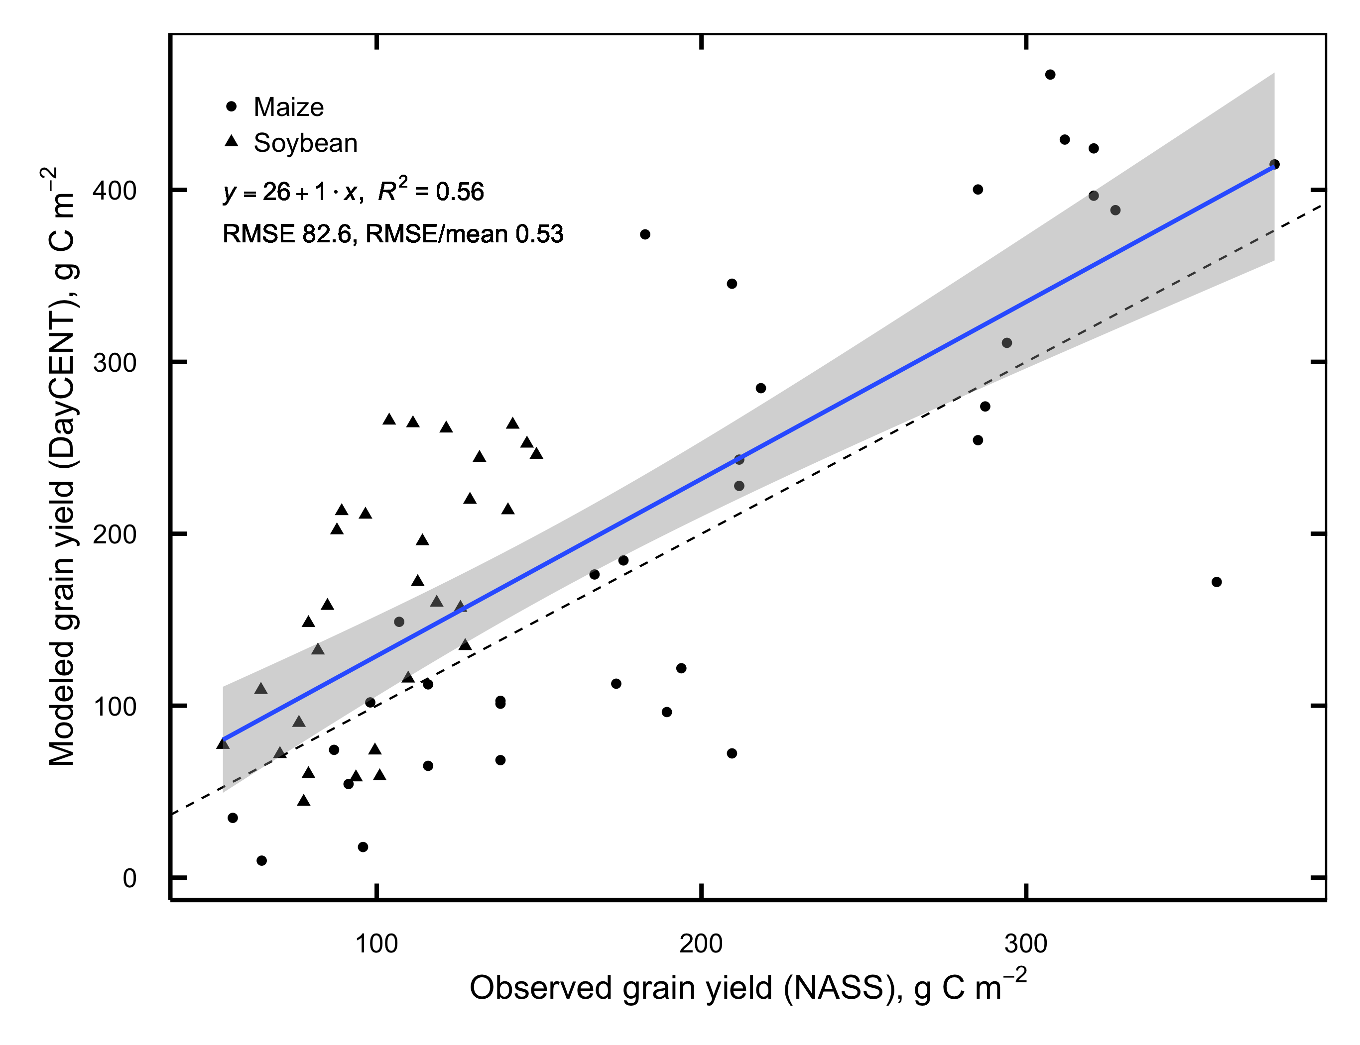
Notes:
Modeled maize and soybean yields from the 20th century match well with USDA records of Champaign county average yields for the same years.

Slide 21
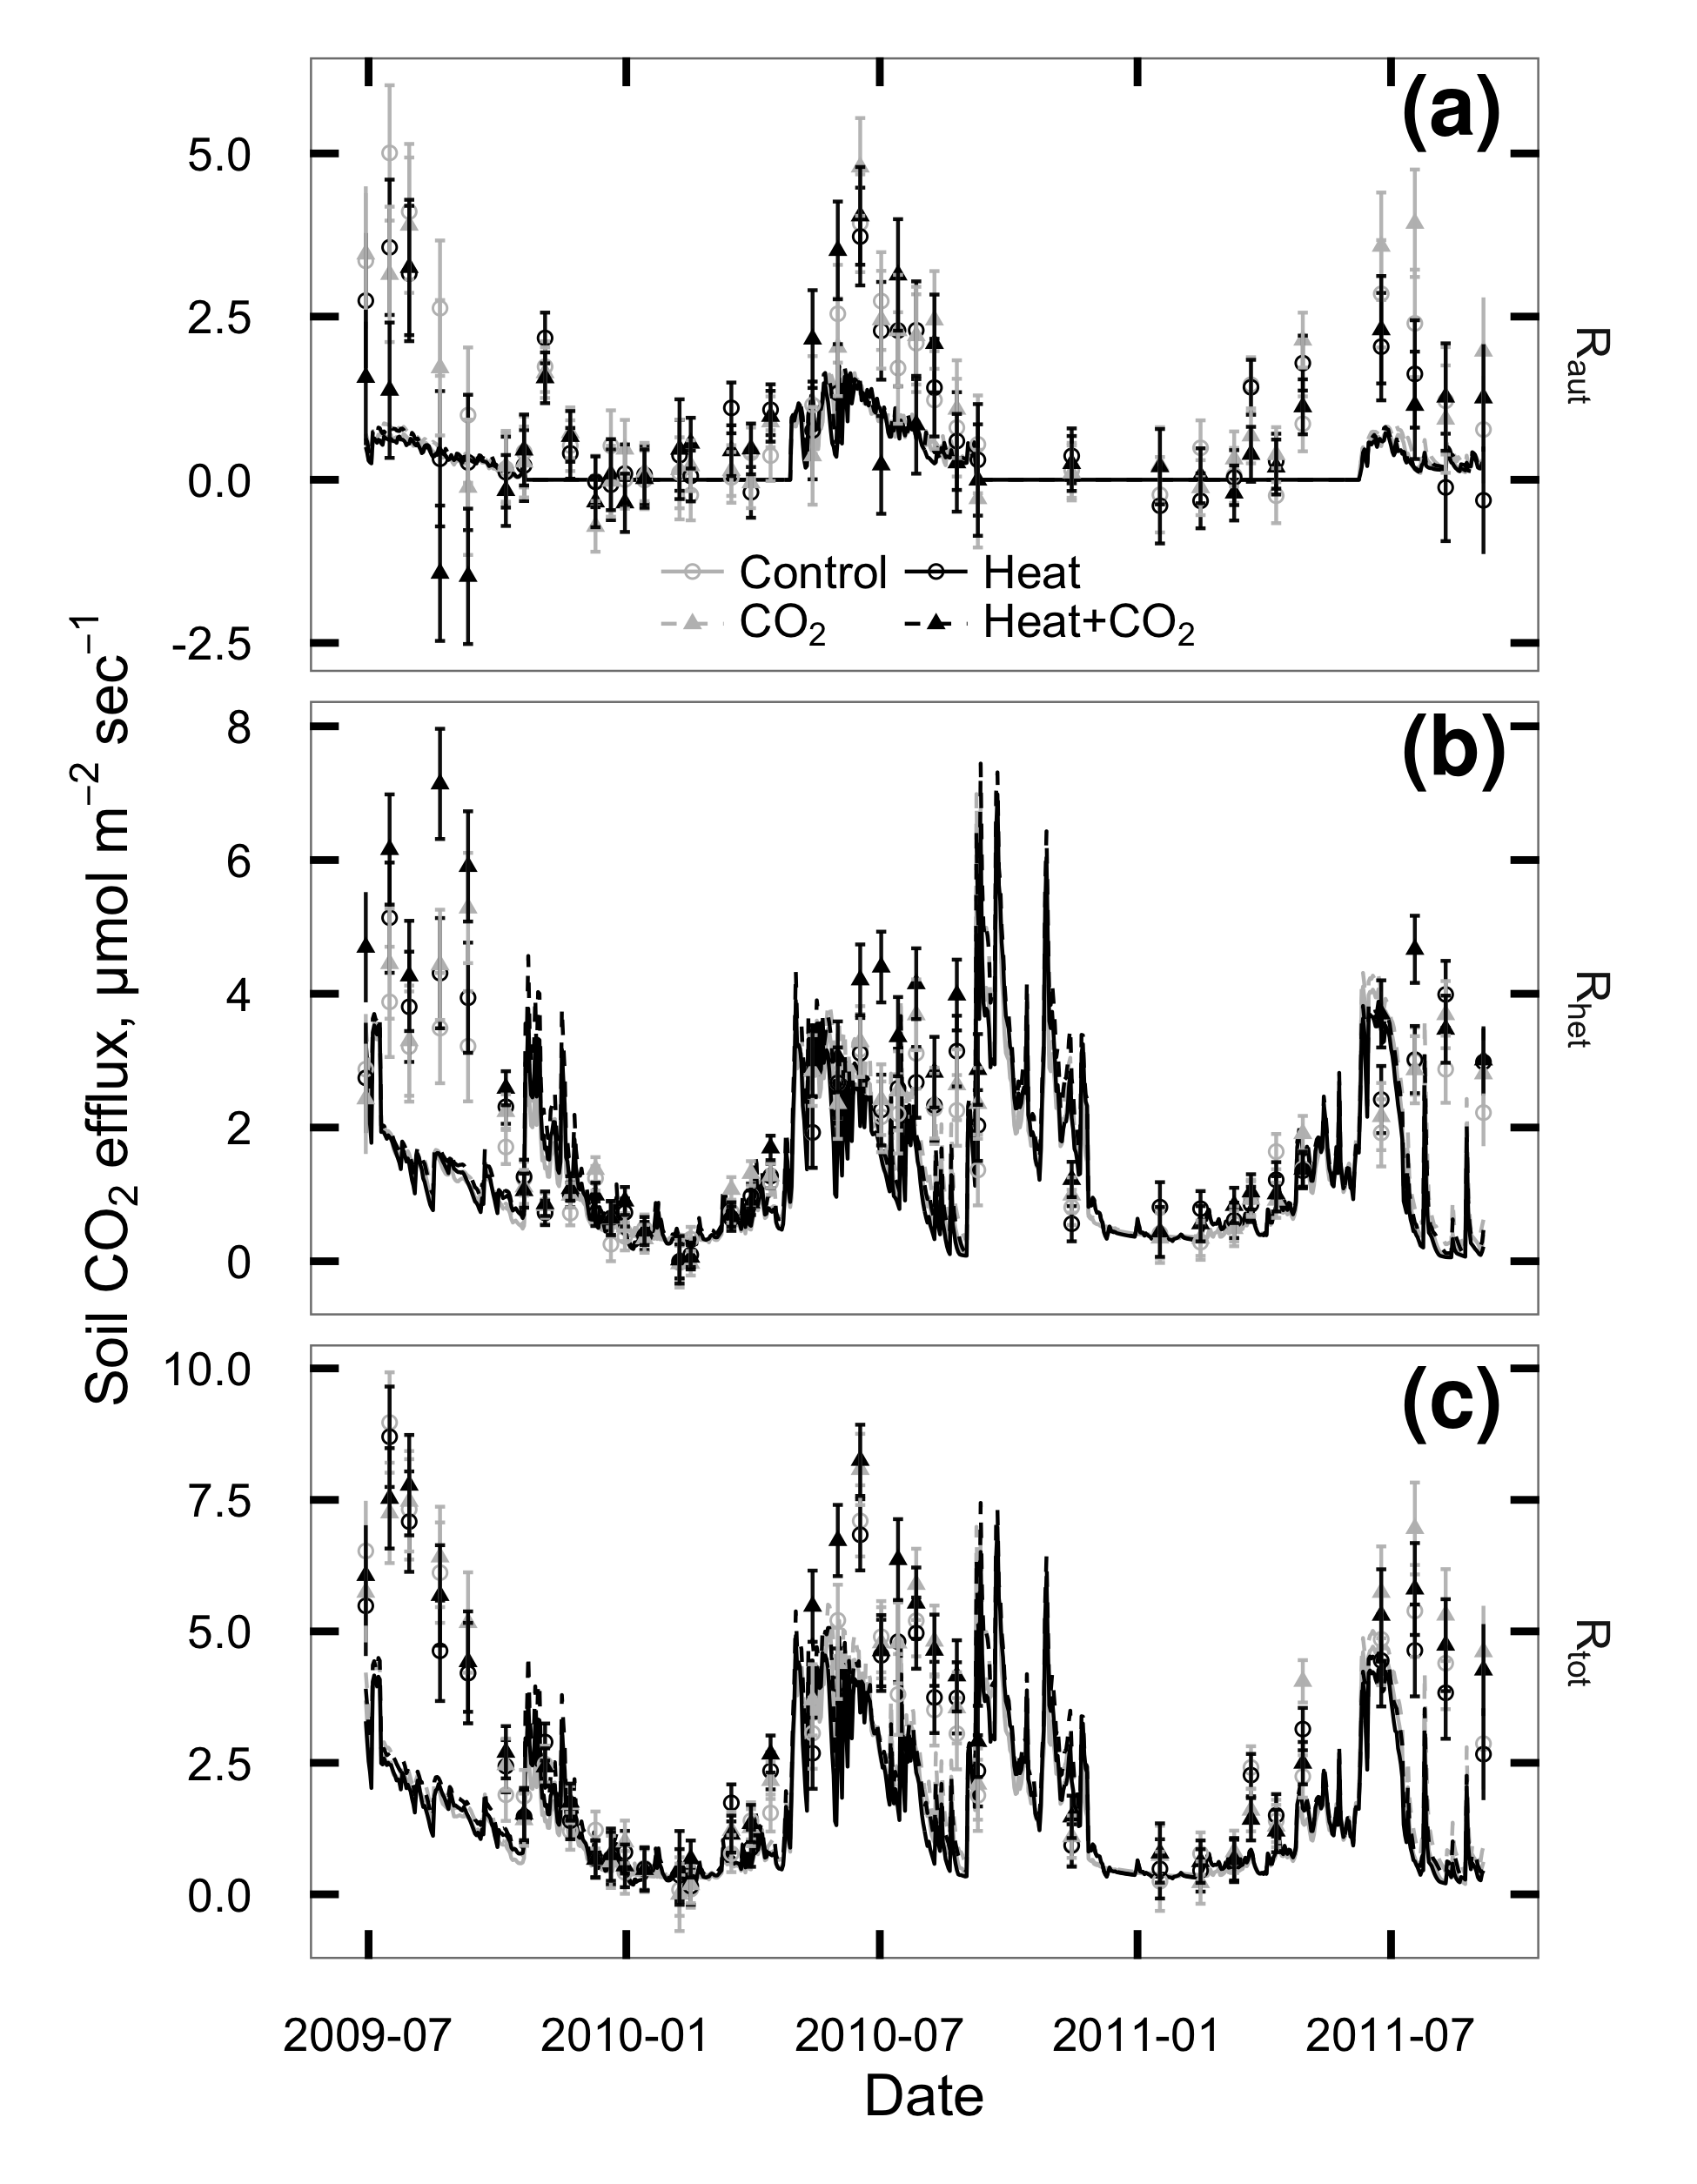
Notes:
Modeled microbial respiration is in the right range, and shows same direction of response we saw in the field.
Modeled root respiration is lower than measured, but seasonal responses line up well.
➔ So we’re reasonably confident that the soil C pools are correctly calibrated and the crop & microbe models capture observed responses.
Now let’s run it out into the future both with and without the heat and CO2 treatments.

Slide 22
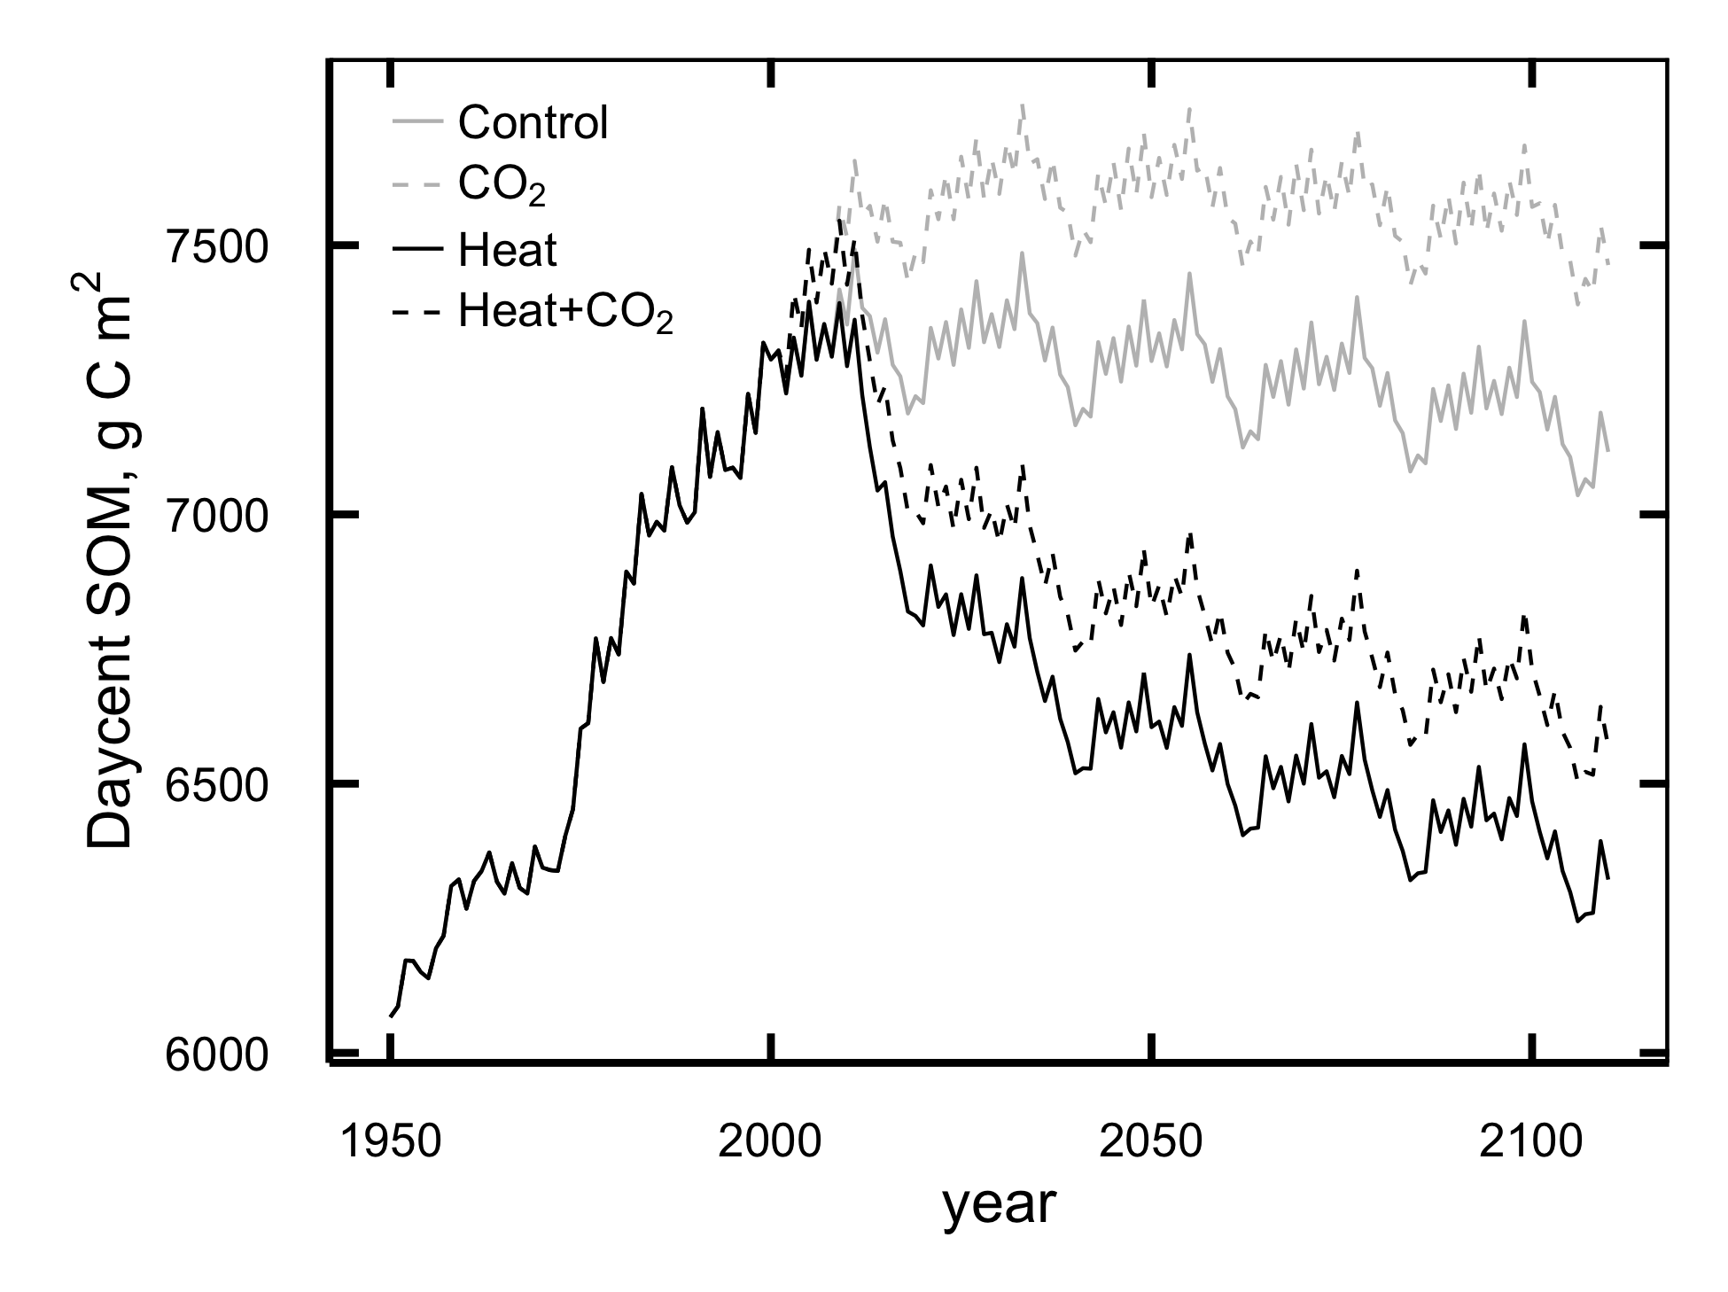
Notes:
Waa-waaaaa.
DayCent predicts that with long-term continued heating and higher CO2, the overall effect will be a very substantial loss of soil C.
Possibly enough to erase all the gains from conservation tillage since the 1970s.
Daycent does not predict any CO2 priming effect like what we observed, BUT there is no mechanism in the model to allow it.
(Daycent uses a black-box microbe model, priming responses require explicit microbe physiology)
So result could be even worse than what’s shown here.
So that was the business as usual scenario, and it’s grim.
Soil C loss will produce an acceleratign feedback on climate, and probably reduce fertility as well.
Let’s think about some other possible management plans.

Slide 23


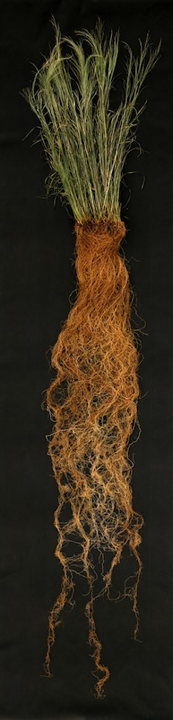
How to store soil carbon:
[ ] High inputs
[ ] Physical protection
[ ] Low disturbance
Steve Renich, Wikimedia
Joel McKinney, The Noun Project
Notes:
Perennial grasses seem like good candidates for this:
They have large root systems,
slow-decaying roots,
place C into deep soil layers,
and are rarely tilled

Slide 24

Root volume distribution of maturing perennial grasses revealed by correcting for minirhizotron surface effects
Christopher K. Black, Michael D. Masters, Kristina J. Anderson-Teixeira, David S. LeBauer, Evan H. DeLucia
Notes:
A major part of the C loss we saw in the maize-soybean system is attributable to annual tillage.
40% of the maize grown in the US goes to production of fuel ethanol.
What if we could produce more ethanol per acre from a crop that doesn’t need annual tillage?
Popular candidates for this job: High-yielding perennial grasses such as switchgrass and Miscanthus

Slide 25
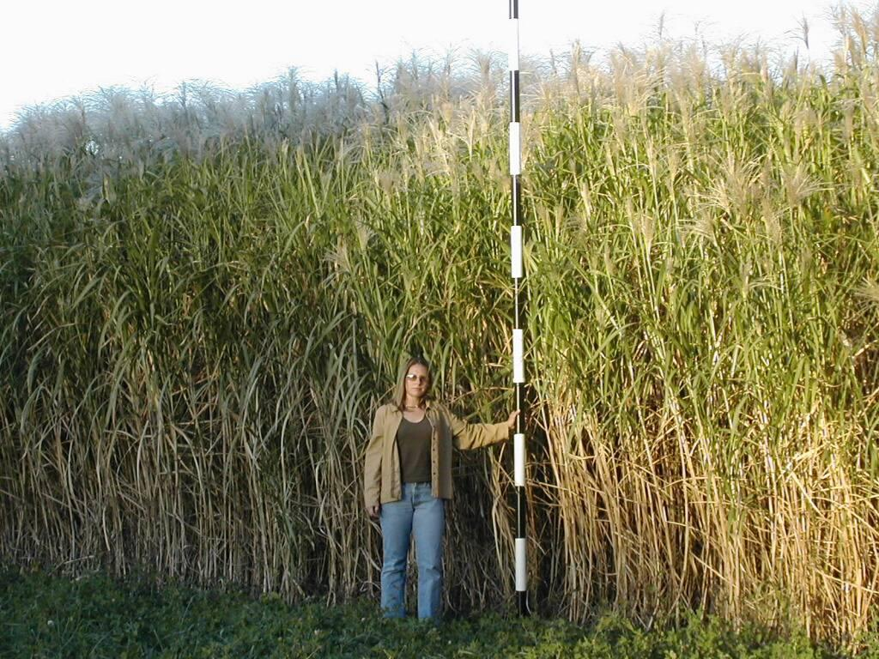
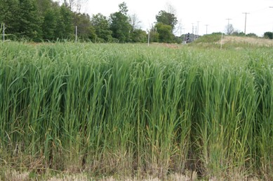
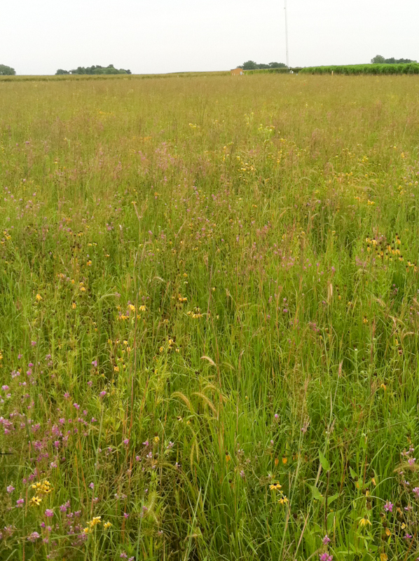

Notes:
Results from Energy Farm, a side-by-side comparison of production and biogeochemistry of three potential bioenergy feedstocks
miscanthus, switchgrass, prairie compared to the corn-soy rotation.
N=5, Planted in 2008, will show results spanning years 3-7.
My particular interest: How much root is getting allocated to very deep soil?

Slide 26
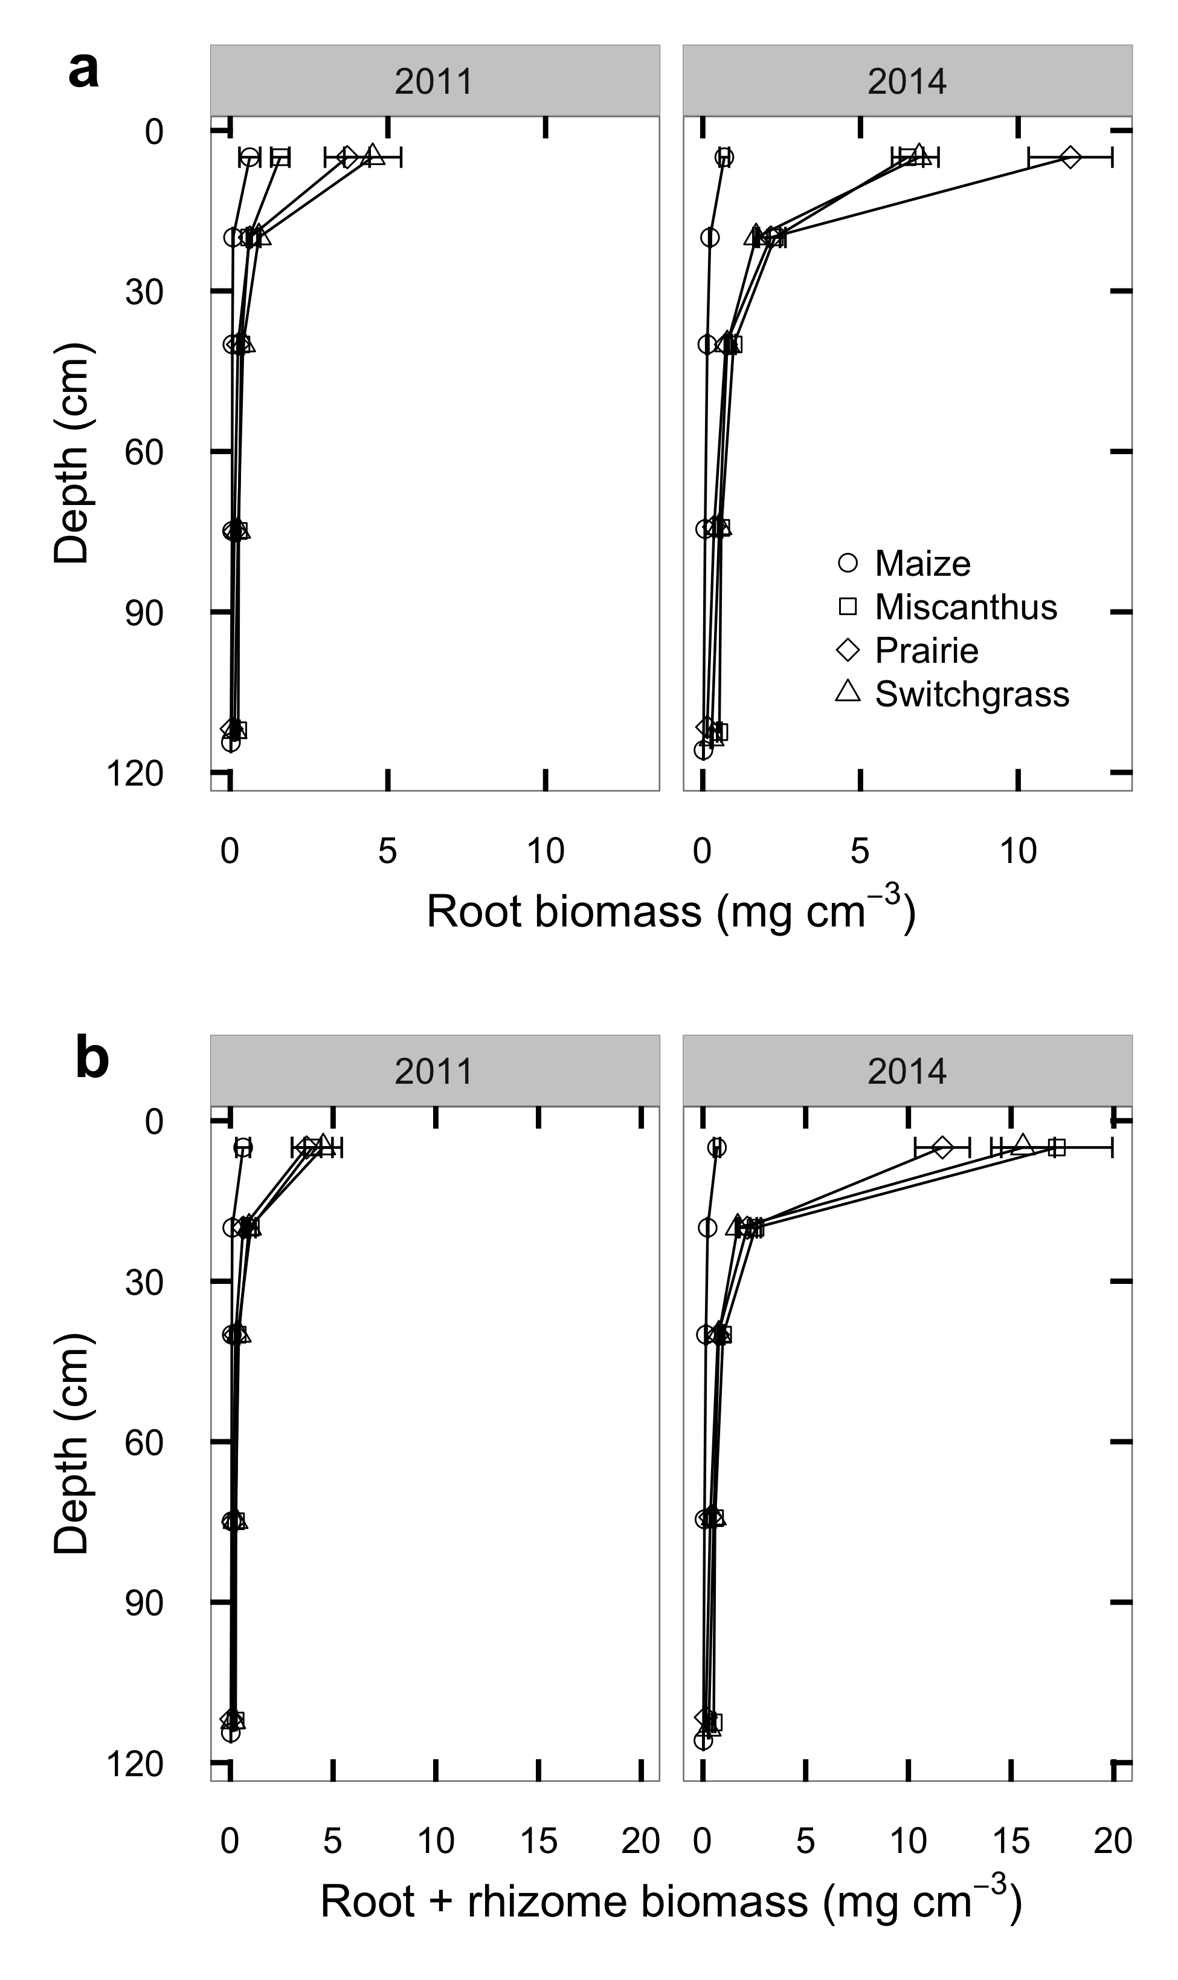
Notes:
Collected deep root cores shows that once established, all 3 crops have a LOT of roots.
Will show many figures like this: Y-axis is depth with surface at top
X-axis is biomass.
Top panels: mean +/- SE of roots alone, 2011 & 2014

Slide 27
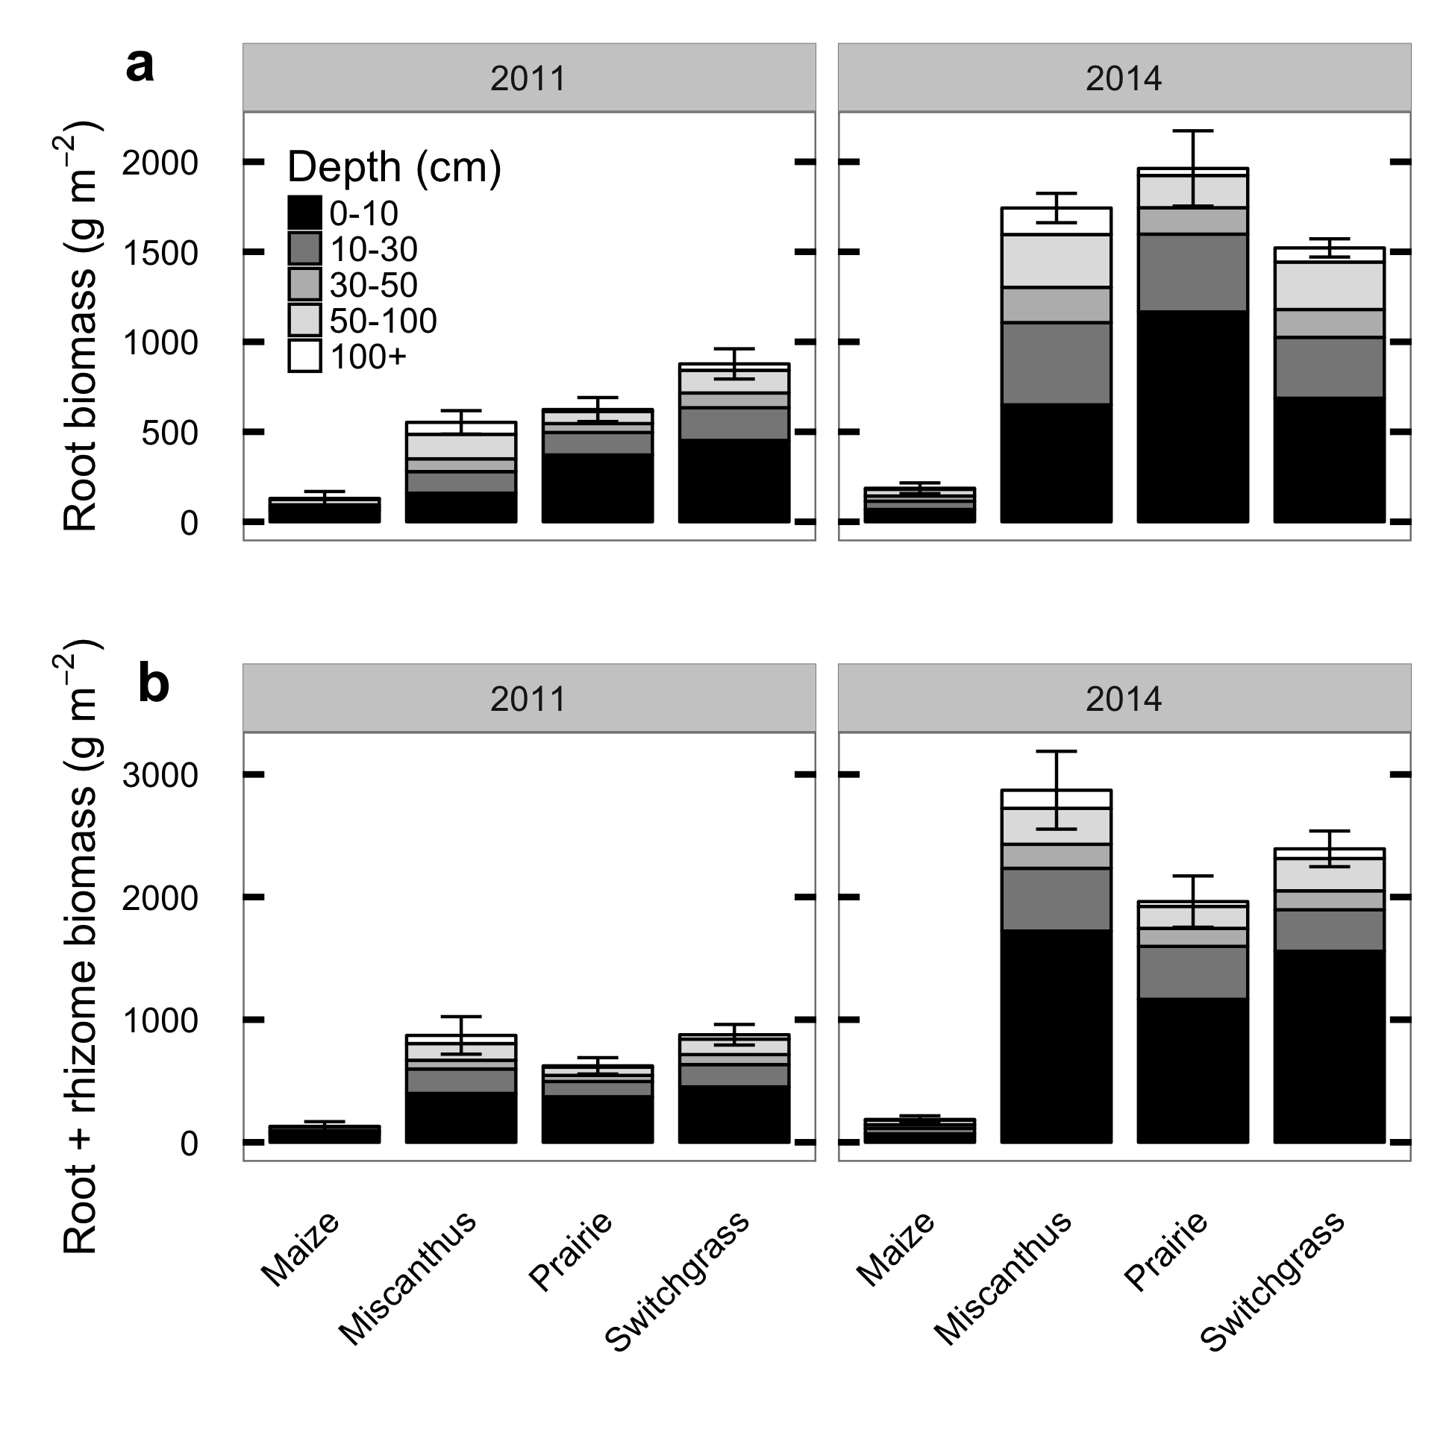
Notes:
Same numbers as previous figure, but now on an area basis instead of per cm^3.
Notice that all 3 perennials have more root below 50 cm than maize has in the whole soil profile!
But these cores are just snapshots taken once in the middle of the summer –
need heavy equipment to collect them, too destructive for regular monitoring

Slide 28
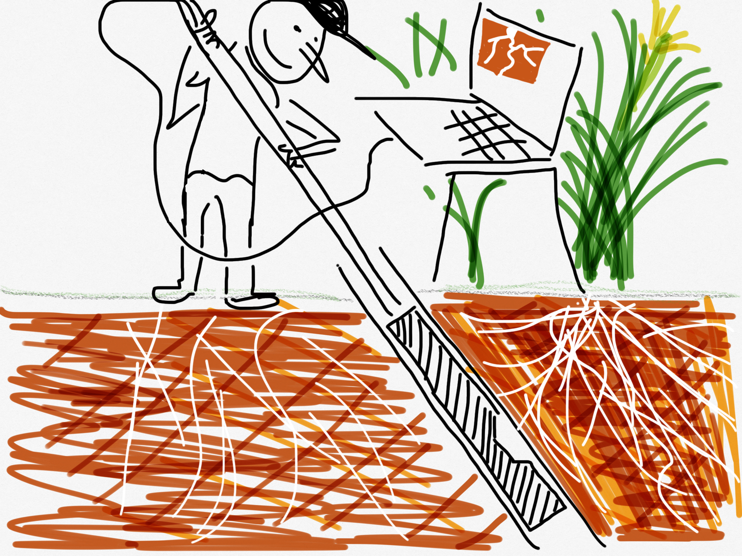
Notes:
Want better temporal resolution on deep roots – can’t core very often,
So used a minirhizotron camera: Install clear plastic tubes in the ground, lower camera down, collect images.

Slide 29
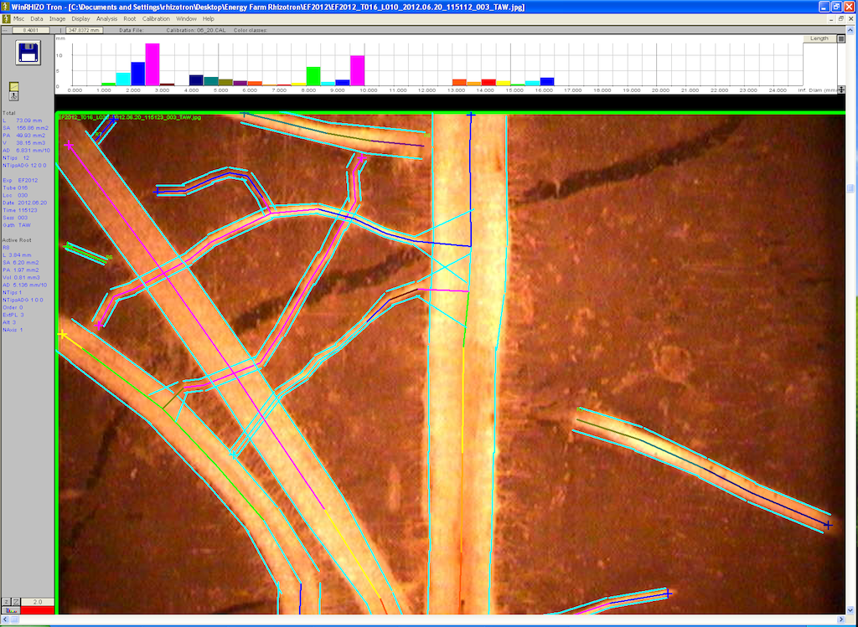
Notes:
Take each image, put it up on the screen, digitally trace length and width of each visible root segment
calculate the volume of each segment as a conic section, and see...

Slide 30
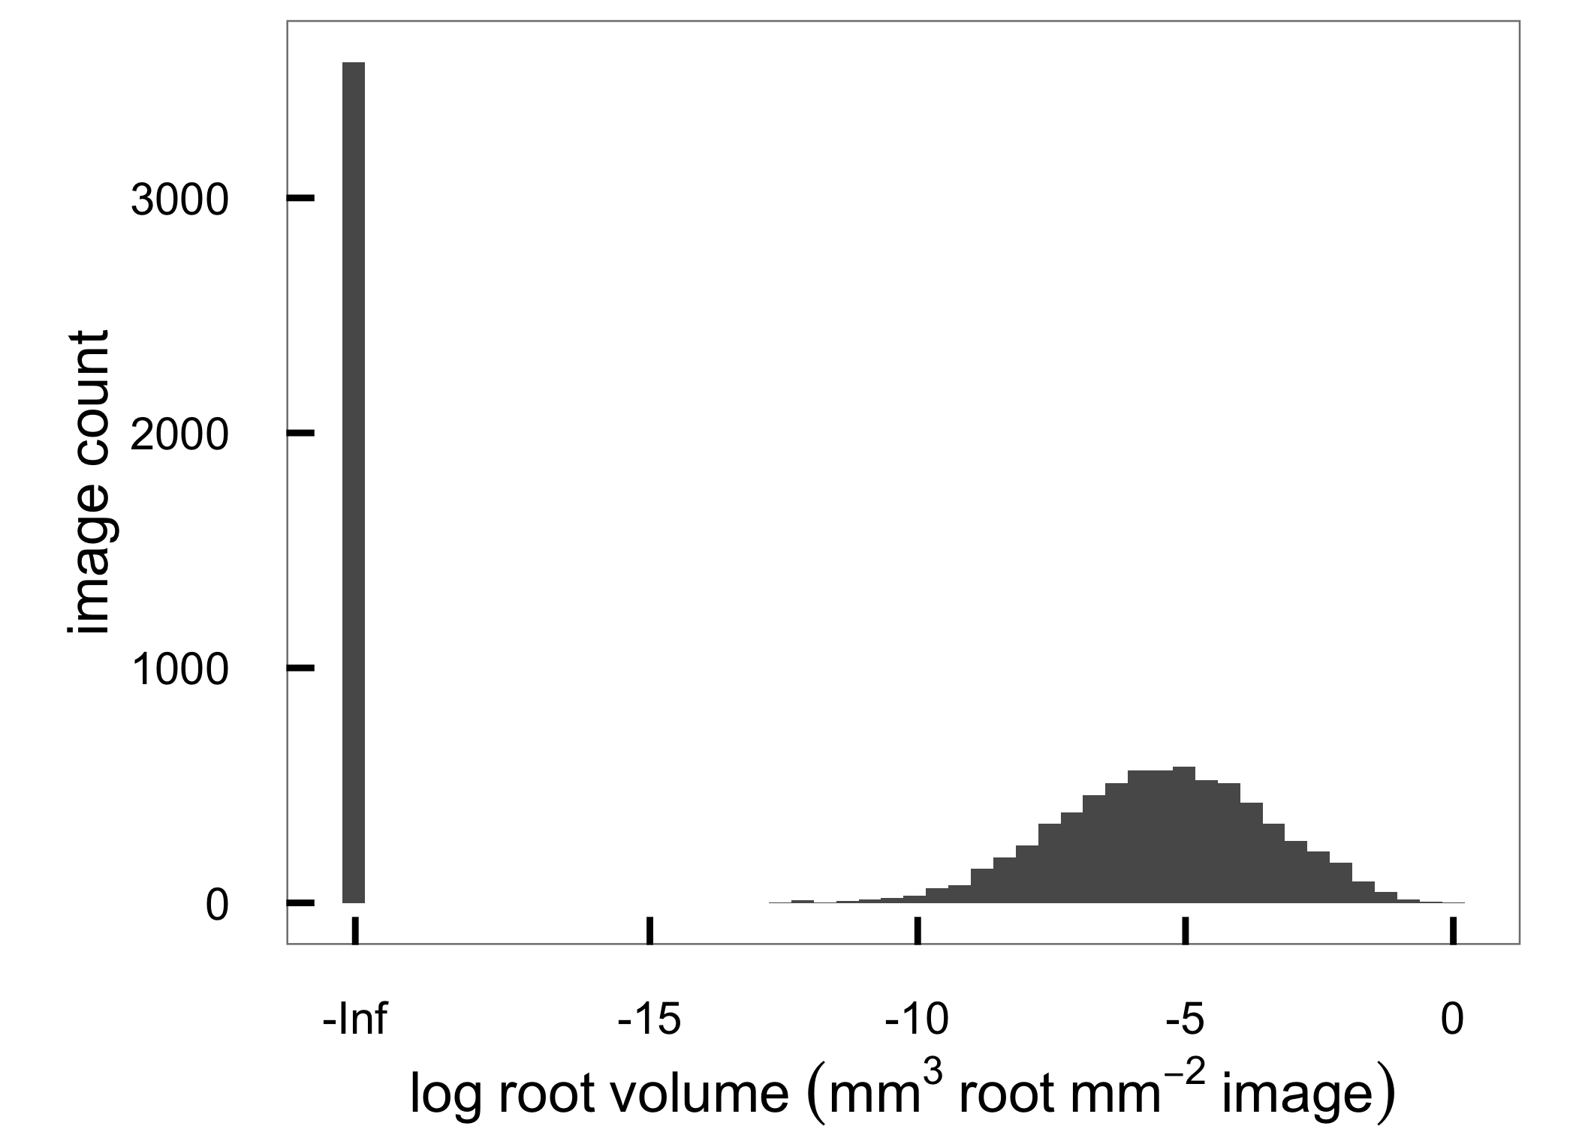


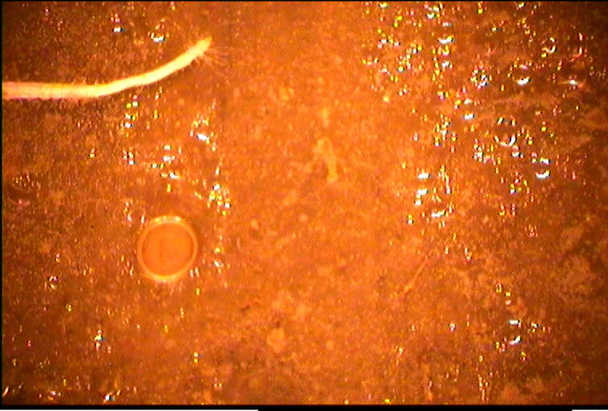
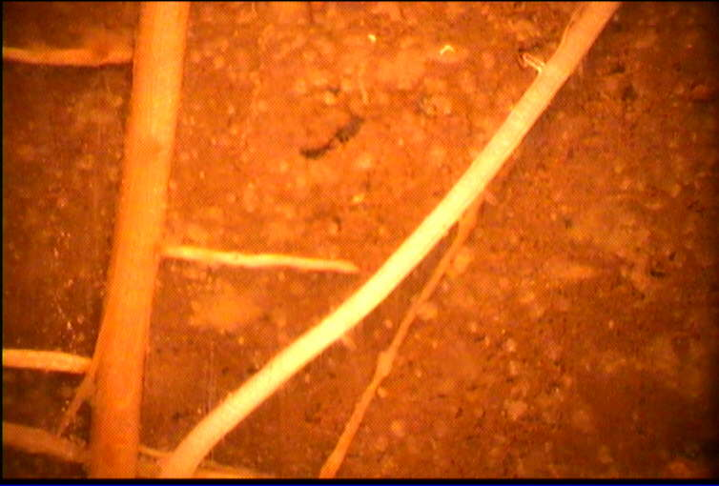
/ /
/ /
Notes:
Penny for scale.
Each image is very small and many contain no roots at all,
even in locations where we expect a lot of root on average.

Slide 31
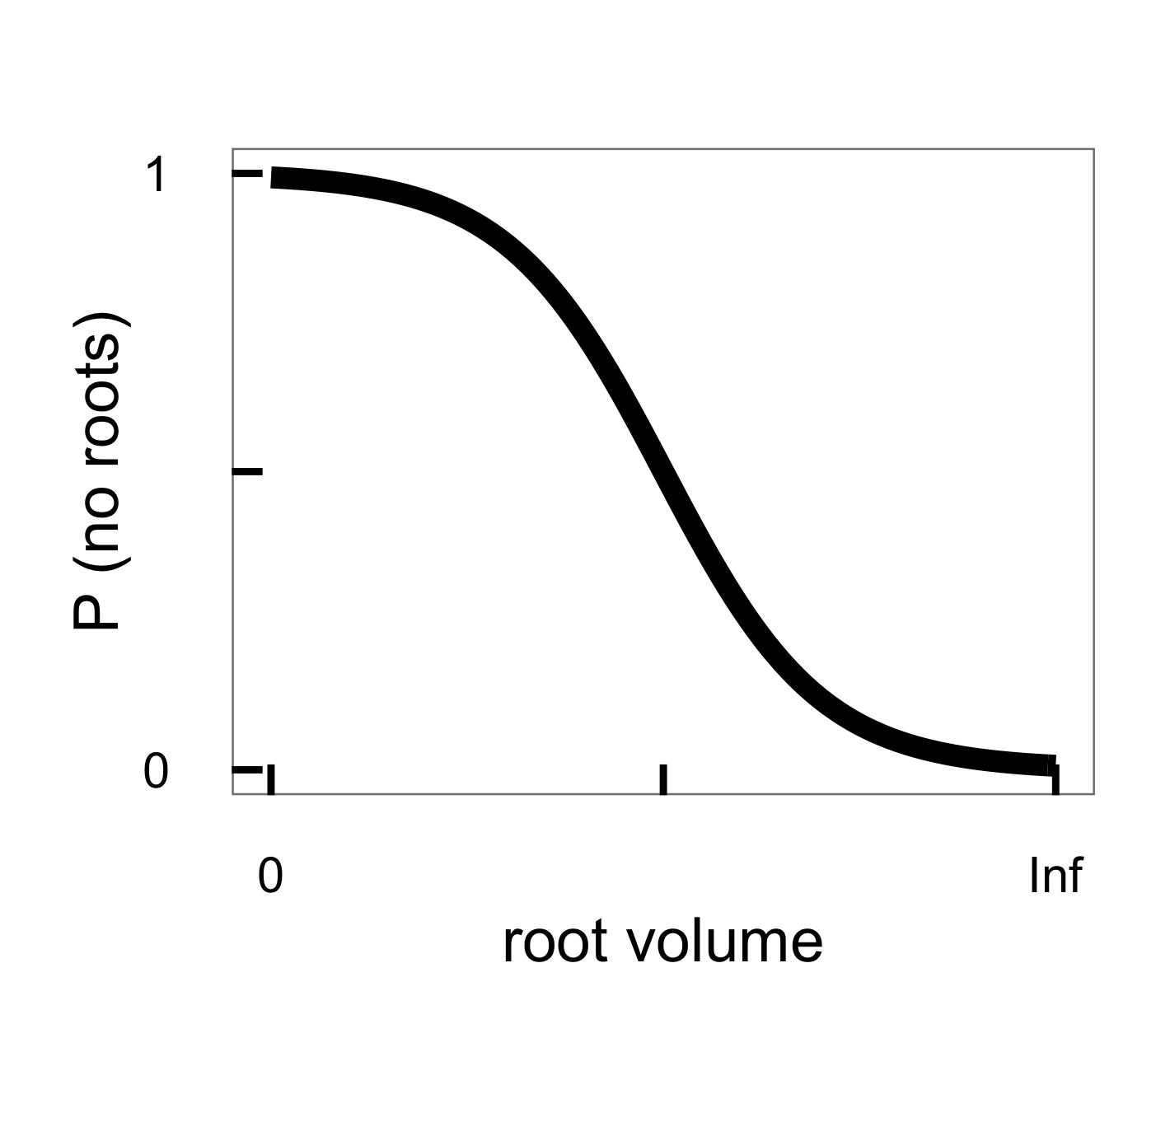

/ /
/ /
Notes:
We account for this by modeling root volume as a mixture of zeroes and lognormal nonzeroes
The fraction of zeroes varies with mean root volume
According to this logistic function.

Slide 32
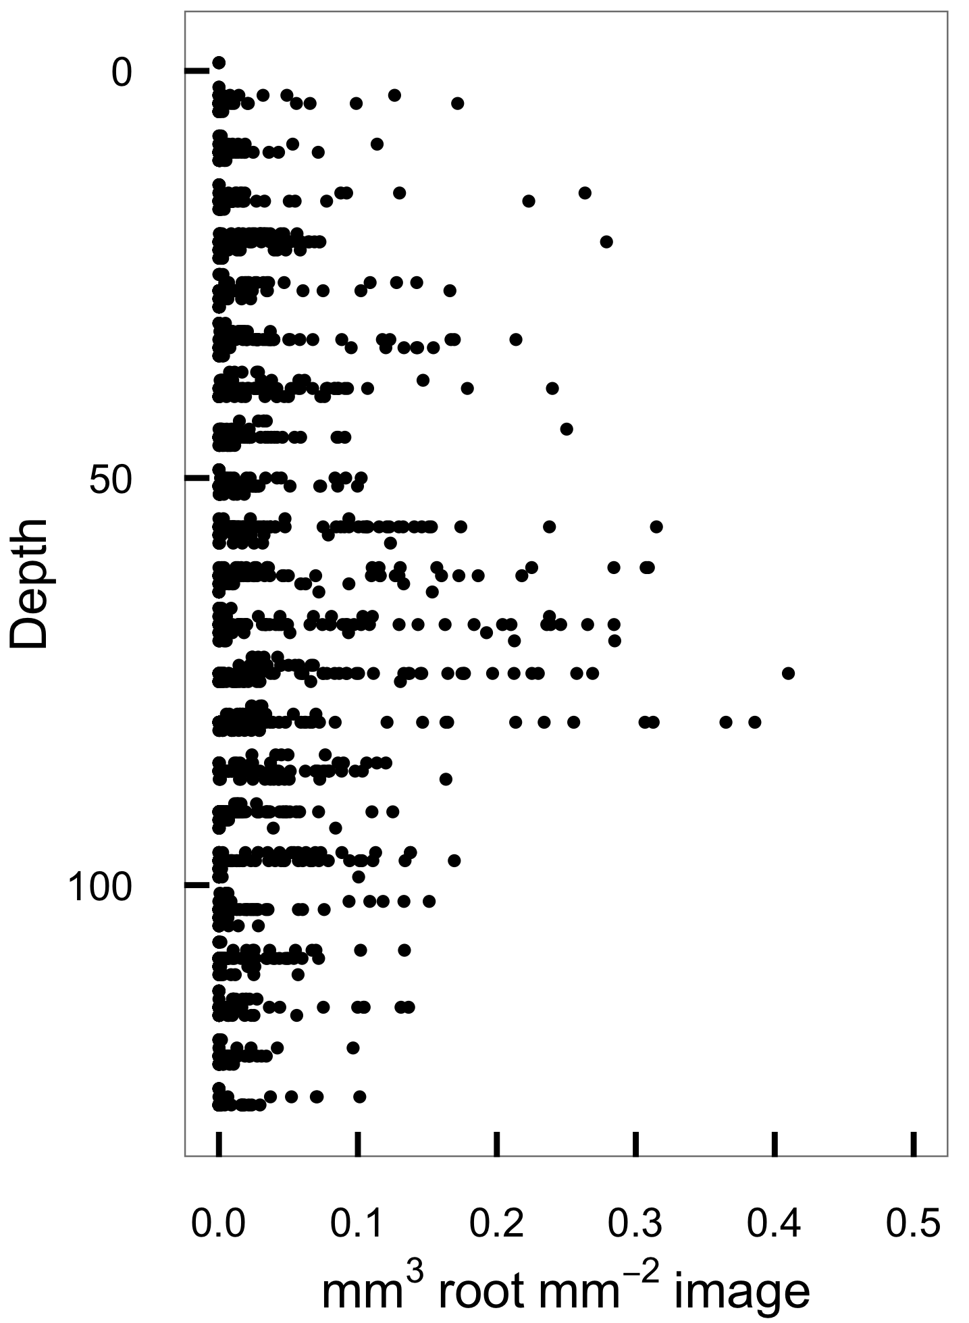
Detection is low near surface
Images (volume)
Root cores (mass)
Notes:
Rhizotron images on the left, root cores on the right
Where are all the surface roots?

Slide 33
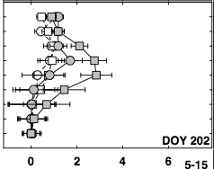
Detection is low near surface
Gray et al., 2016
Images (volume)
Root cores (mass)
Notes:
A persistent difference between minirhizontron and coring studies that ~everybody sees:
Roots very near the surface are underdetected by minirhizotrons.
This is probably related to soil-tube contact.

Slide 34
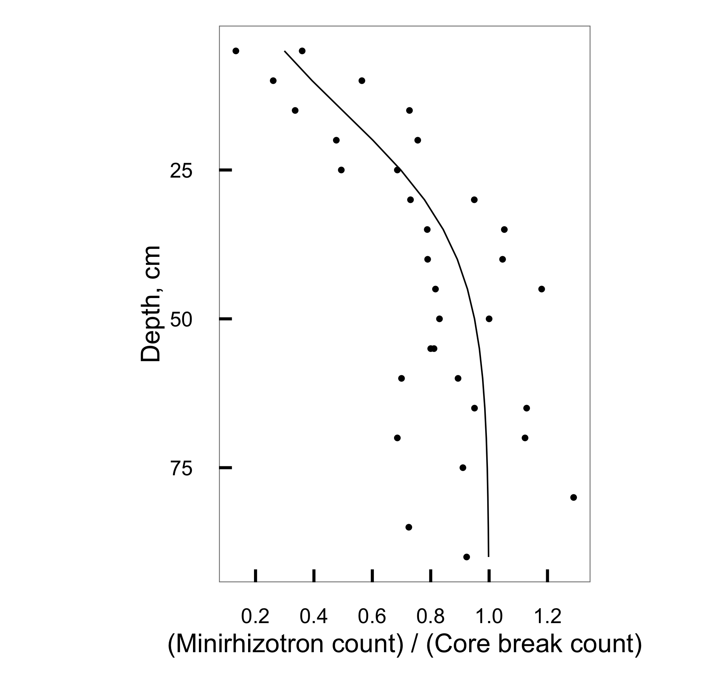
Detection is low near surface
…and decreases predictably with depth
Bragg et al., 1983
Notes:
The underdetection is systematic and follows a predictable pattern
-- so we can correct for it.
We model observed root volume as a function of true root volume that increases to 1 with depth.

Slide 35
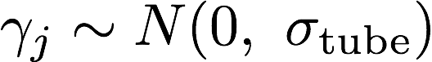

Detection is low near surface
…and decreases predictably with depth
Bragg et al., 1983
,
Notes:
After correcting for the depth effect, we then model true root volume as a log-linear function of depth with offsets for crop, sampling location, and residual error.

Slide 36
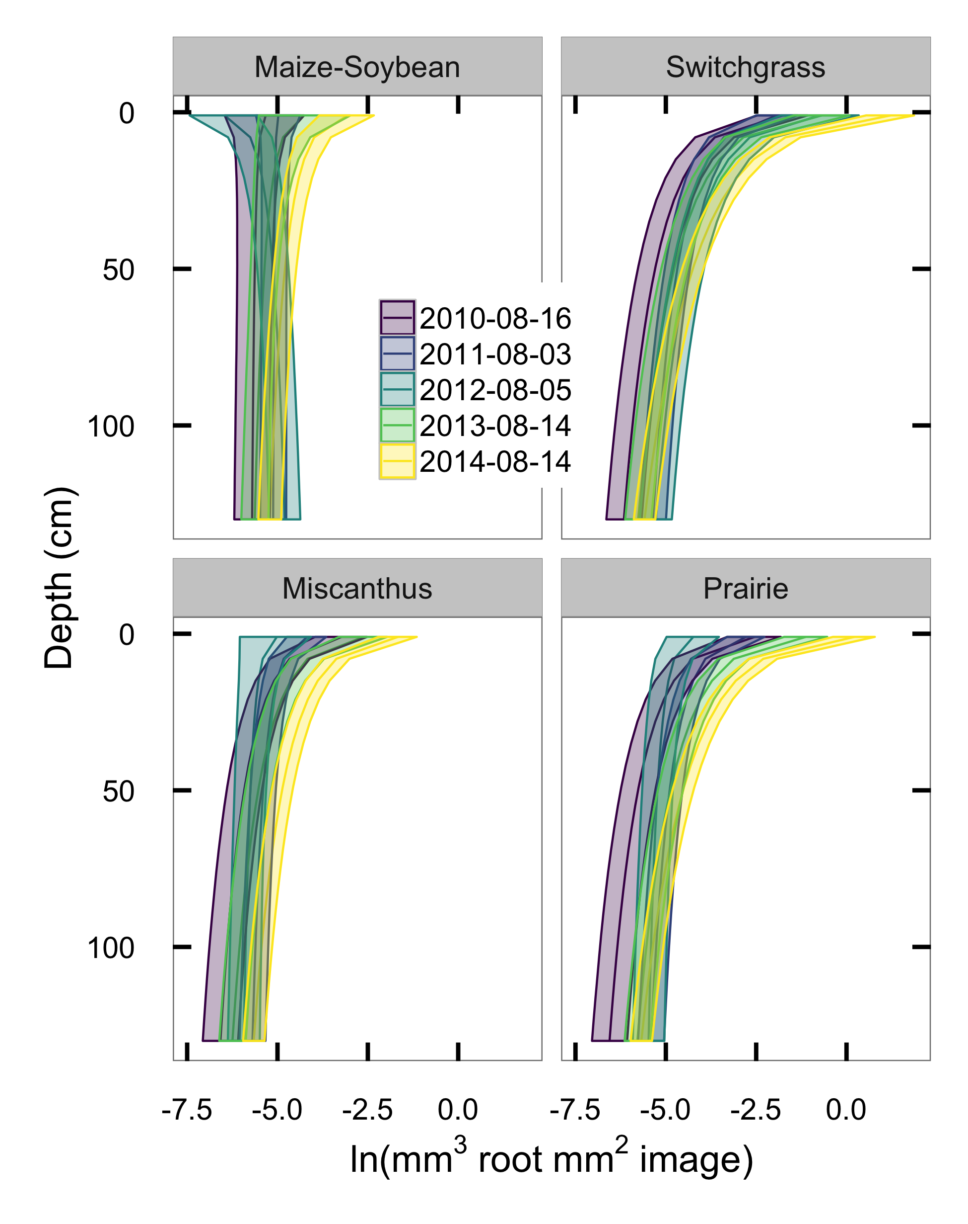
Notes:
What do we get? When we look at peak biomass each year, see patterns much more like expected from cores.
maize and soybean root volume less than perennials
Miscanthus less concentrated near the surface (=potentially good for soil C)

Slide 37
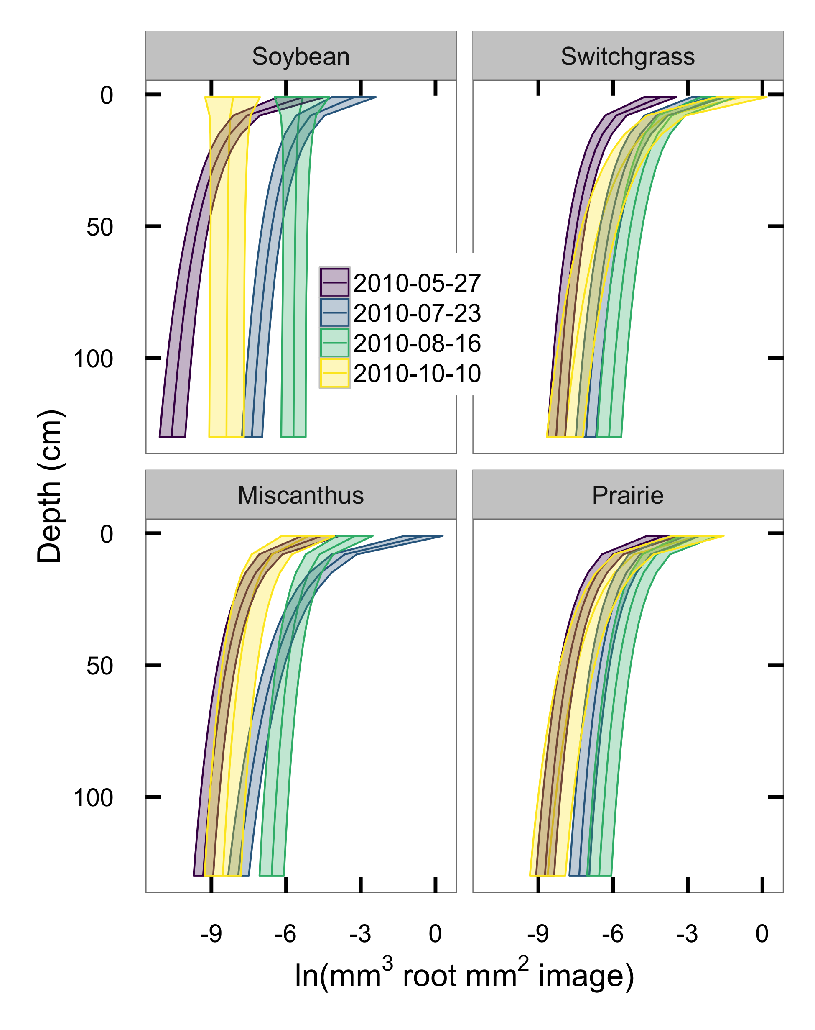
Notes:
Repeated imaging over time:
In 2011, can watch soy roots grow out starting from the surface, explore deep soil, and die back
Perennials add mass everywhere, show a small end-of-season drop

Slide 38
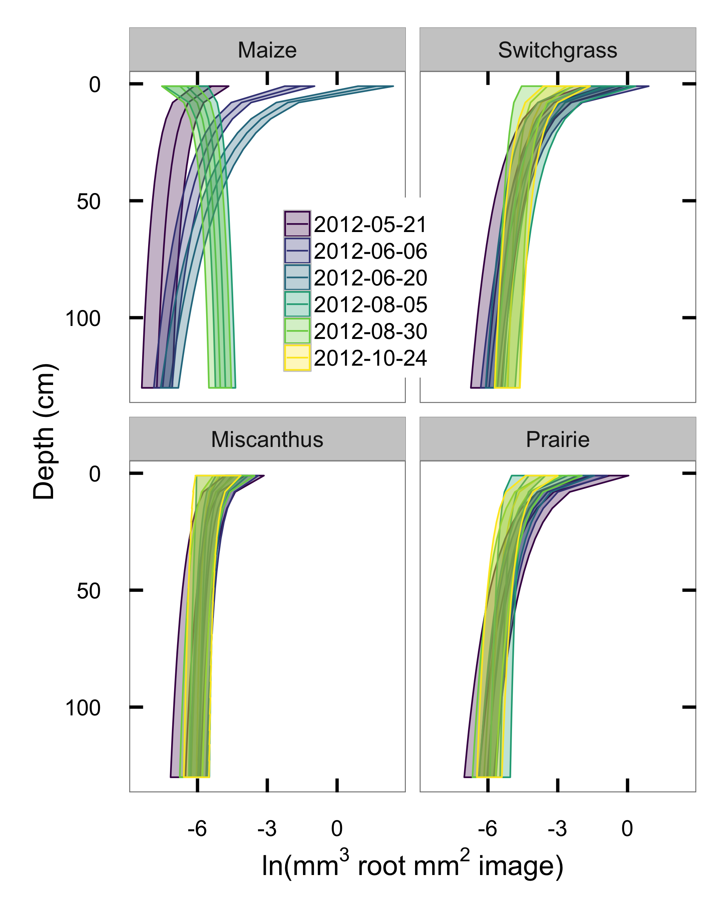
Notes:
In 2012: Maize shows dramatic seasonal cycle, perennials barely move.
No Oct sample from maize because already harvested
Limitation: Maize root volume probably overestimated easly in the season—
Underdetection correction needs deep roots to work well!

Slide 39
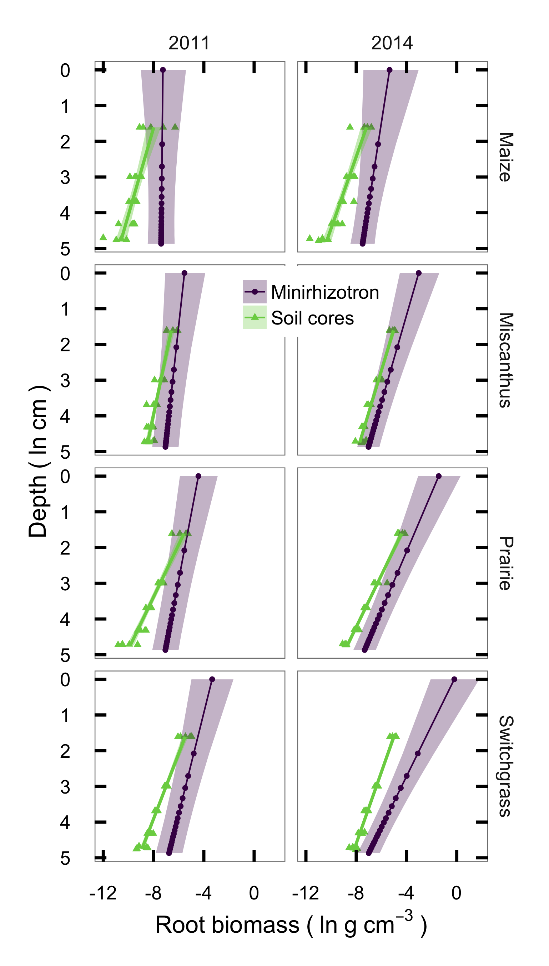
Notes:
Model estimates root VOLUME per unit AREA,
Cores measure root MASS per unit VOLUME.
If I assume a 0.78 mm depth of view (Benton Taylor and Seth Pritchard),
And root tissue densities from the literature (0.08 maize, 0.20 mxg, 0.19 switch, 0.15 prairie)
Then cored (green) and imaged (grey) root mass are at least vaguely similar?
(This should be a direct regression; need to rerun model to get that)

Slide 40
Statistical model reconciles rhizotron and core data
Non-destructive sampling
allows monitoring of detailed temporal dynamics
Defensible mass estimates from 2D images!
Opens door to automation of the imaging process
-----
How to store soil carbon:
[✓] High inputs
Perennials >4x more root than corn
Standing root stock still increasing in year 6
[✓] Physical protection
~25% of roots are in deep soil layers
[✓] Low disturbance
No annual tillage
Resilient to a historic drought

Slide 41

Molecular analysis shows taxonomic partitioning of root placement by depth in a prairie plant community
Christopher K. Black, Scott A. Woolbright, Taylor L. Pederson, Christopher R. Sligar, Evan H. DeLucia
Notes:
In the previous section we saw that a restored prairie supports root mass comparable to high-yielding perennial crops.
Aboveground biomass is a lot less, which makes it less attractive as an biofuel source,
but prairie biodiversity provides ecological and aesthetic value,
requires even less management than grass monocultures
==> Maybe could be grown as explicit C storage

Slide 42
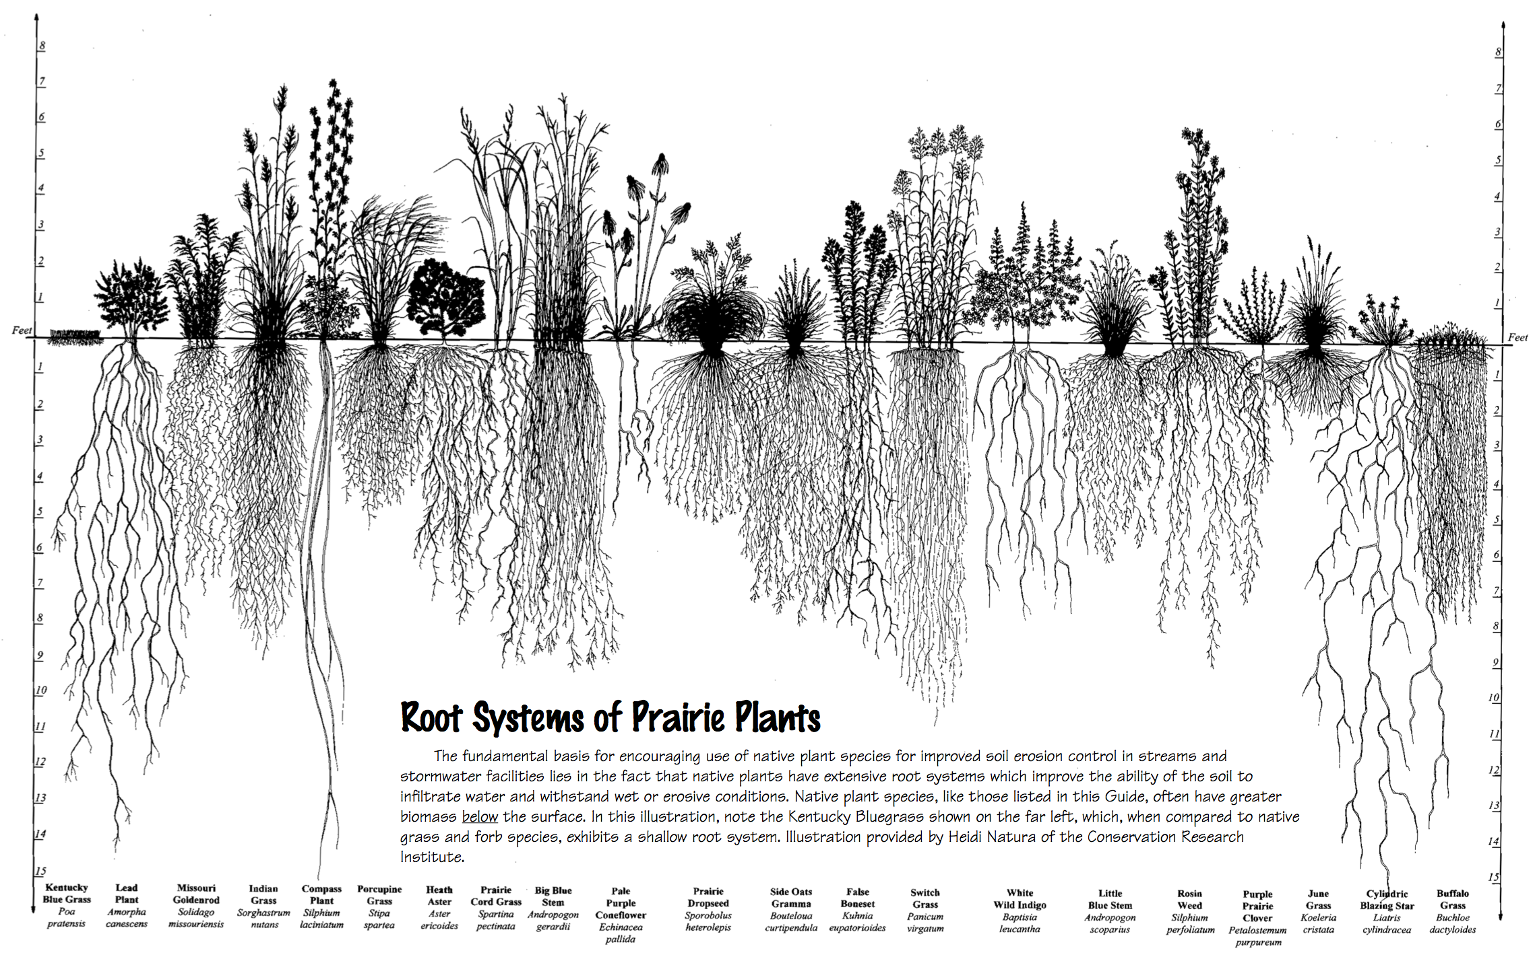

Notes:
Prairie plant communities are highly diverse and contain a mix of functional types
Might expect niche partitioning where some species specialize in access to deep water, others compete harder for near-surface N.
Implication: If designing a prairie mix for soil C storage, what species to use?

Slide 43
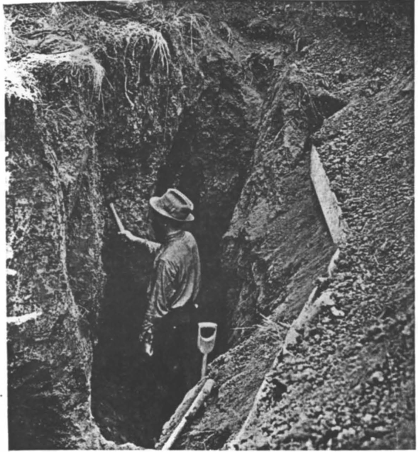
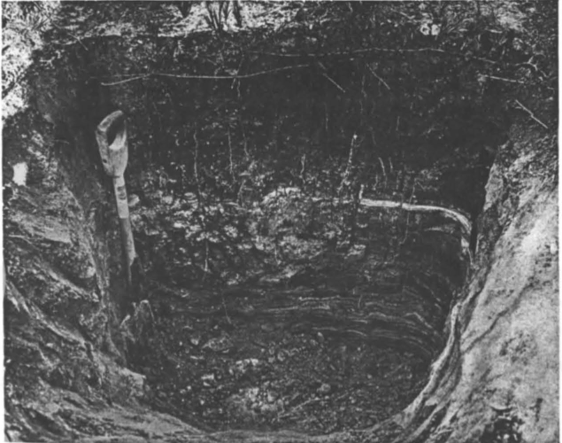
J.E. Weaver, 1919
Notes:
Much of what we know about root structure is visible on previous slide
comes from a lot of previous work, most famously by John Weaver in the first half ot the 20th centruy
Method: Dig a giant trench, literally trace each root back to its crown.
MASSIVE amount of effort, highly destructive.

Slide 44
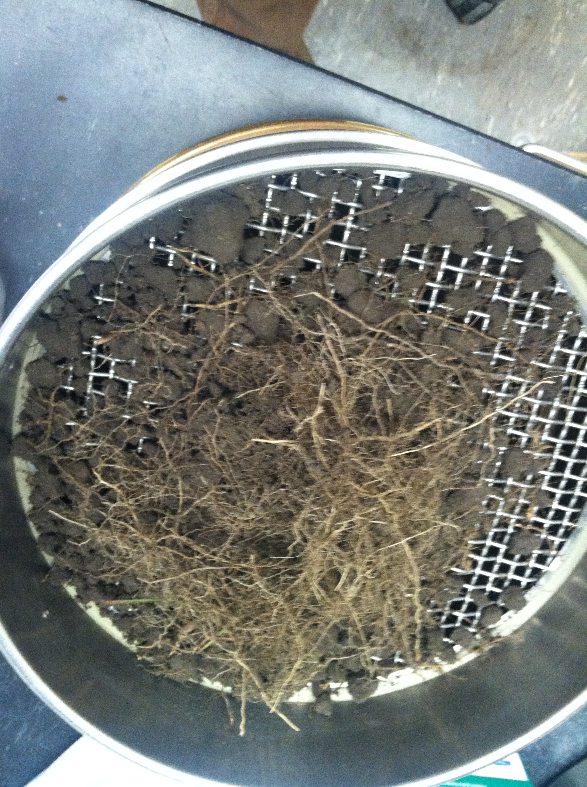
Notes:
But a question arises: Who is storing the C?
All roots look the same.
An approach a few folks have taken before: sample individual roots, sequence, identify by barcode.
Need to run a LOT of individual extractions to get a complete picture of who is in the mix!

Slide 45
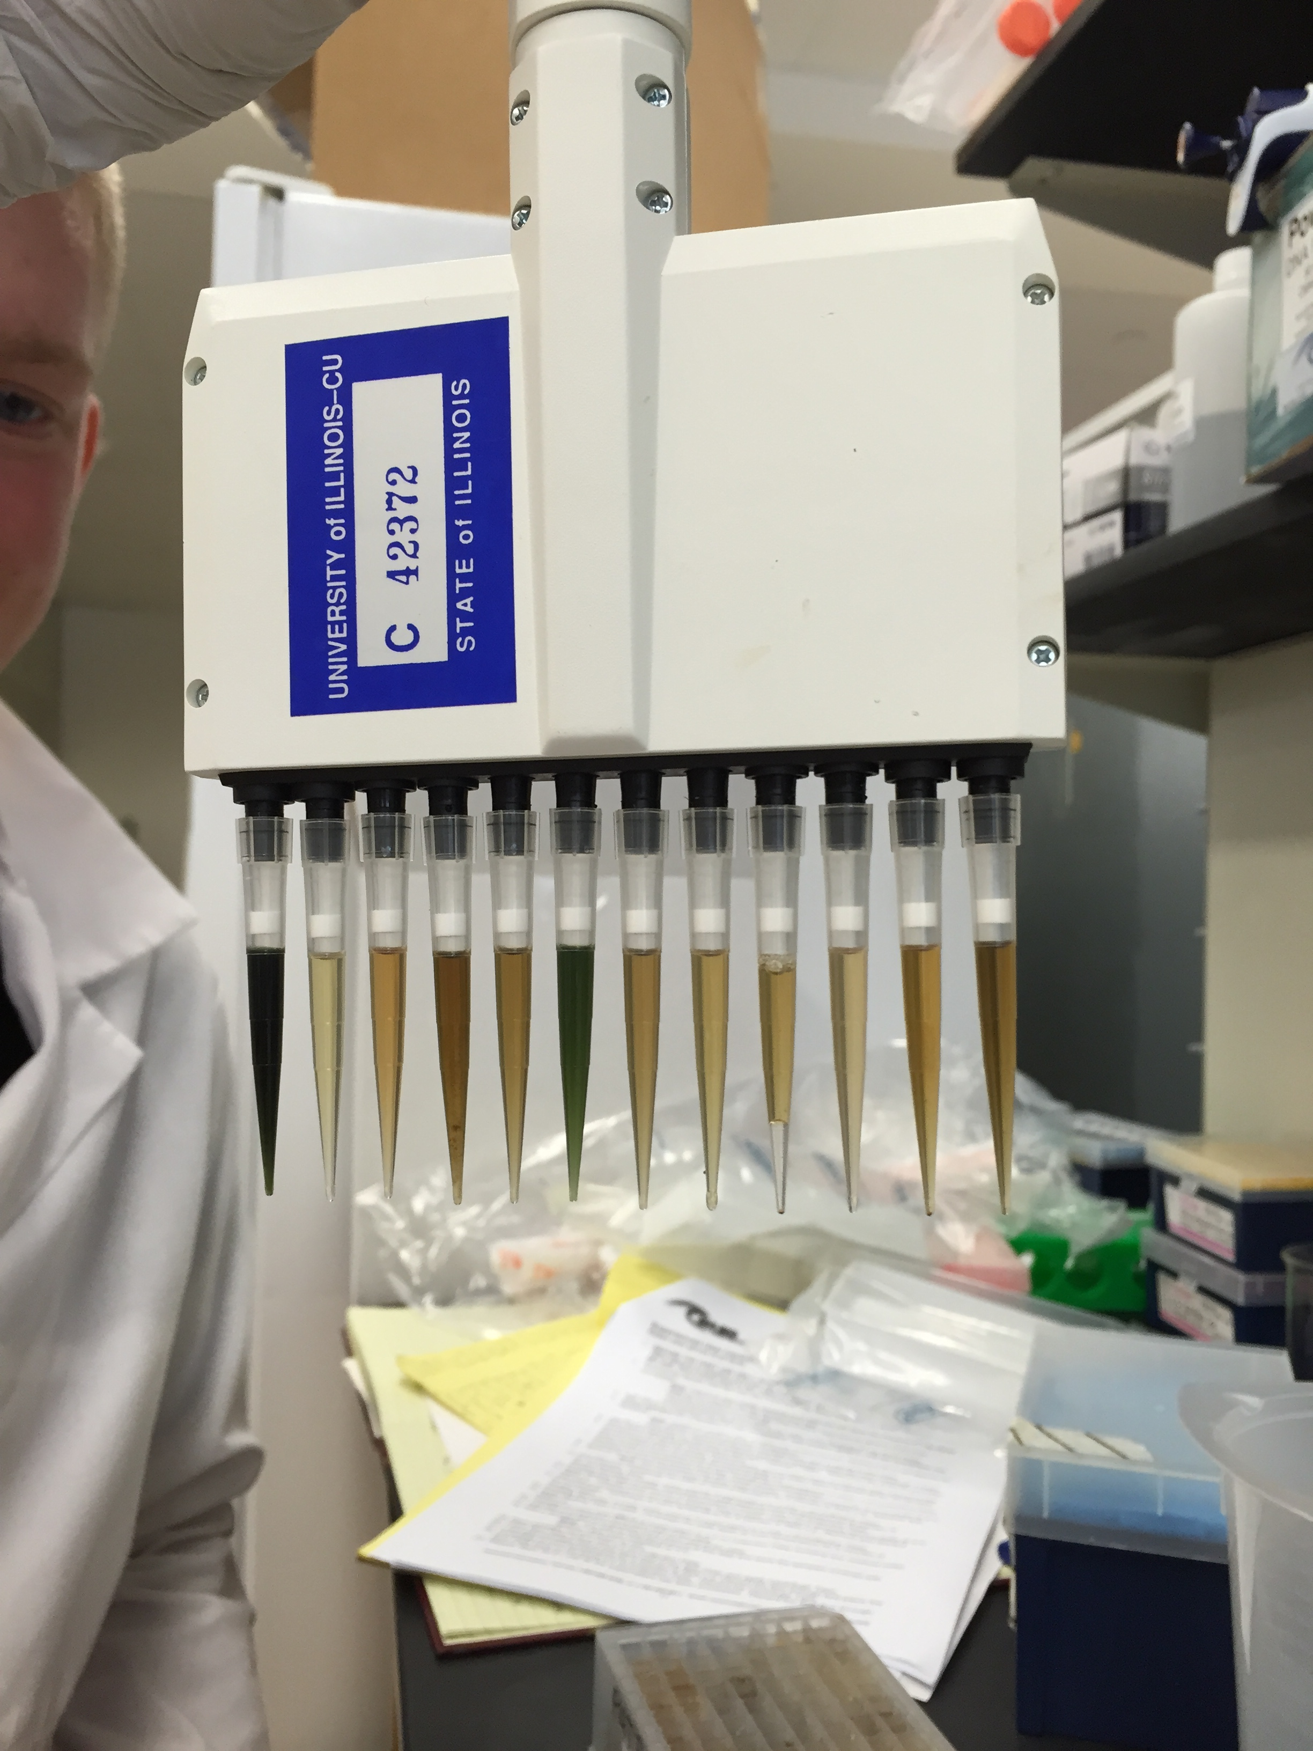
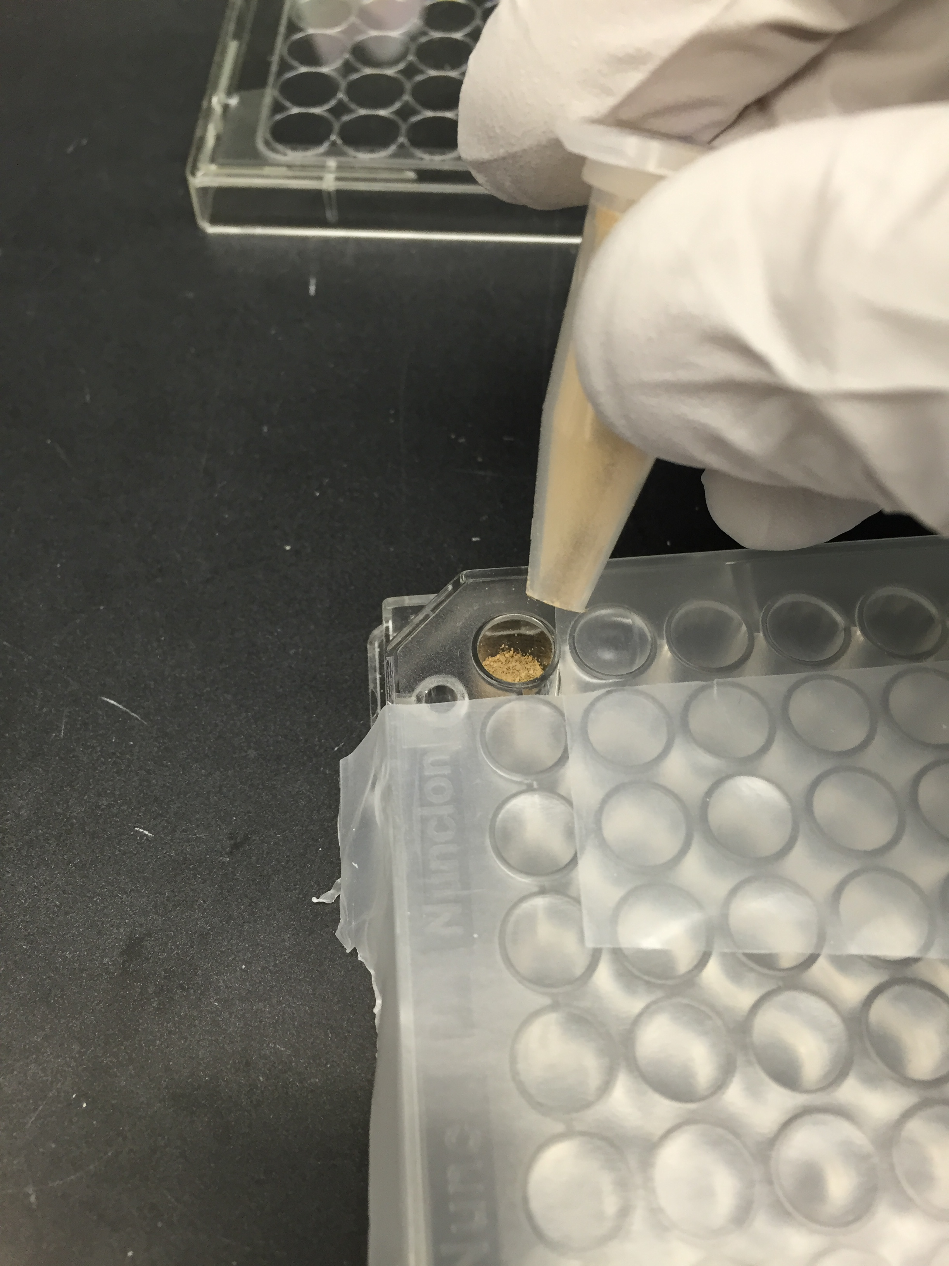
High-throughput sequencing
(Illumina; MiSeq 2x300)
Alvaro Hernandez, W.M. Keck Center
Microfluidic PCR targeting ITS region
(Fluidigm; Access Array)
Mark Band, Carver Center
Filtering & chimera removal
taxa-by-sample matrix
Normalize read counts
Extract ITS2 variable region
Collapse by taxon
Match sequences against full nt database
(BLAST, full nt database)
Notes:
Methods developed for environmental metagenomics now make this tractable
Coring -> hand-picking -> mixed root samples
Extract mixed DNA, send 144 samples to Keck center,
let professionals handle everything in red box
Bioinformatics in bottom row are mostly off-the-shelf

Slide 46
Dicots
Poaceae
Notes:
Within each plot, proportion of genus detected belowground scales with proportion detected belowground – but slope for grasses is much lower

Slide 47
Notes:
Looking across depth, grass detections increase with dpeth, Asters decrease

Slide 48
Notes:
Can’t make a quantitative conversion – DNA recovered per gram root is probably different for every species.
But expect species comparisons to hold between depths.
most near surface detections are forbs ➔ probably most root C is from forbs

Slide 49
Grass
Forb
Legume
Other
Notes:
Nonmetric multidimensional scaling.
Red = grass, green = aster, blue = legume, black or grey = all others to avoid cluttering
Pink (visible?): vectors for depth, soil C, soil N
Grasses associated with deeper layers. Soil C and N not significant once depth accounted for.
But only about 5-8% of total variance from depth. 40% from location! Lots of environmental gradient uncaptured here.
Fact that

Slide 50
Notes:
Let’s put C aside for a second and go back to niche partitioning
Do species aggregate with each other or avoid each other?
Compare to null model of random draws at each location
More pairs of taxa seem to be positively co-occuring than negative
But most are random

Slide 51
Notes:
How does co-occurrence change across depth and higher taxonomic rank?
Grasses tend to show negative co-occurrence with other functional types, positive with other grasses
➔ Spatial partitioning (most other taxa (overdispersed if anything)

Slide 52
• Highly parallel PCR + sequencing = easy root ID
- Taxonomic resolution of ITS2 not a big limitation for this system,
but could probably be improved with a localized database.
Grass roots probably contribute less mass to total than expected
- But need species-specific yields to quantify this
Grasses appear to have distinct ecological role & occupy different spatial niche
- Deeper rooting = more reliable water access, but probably less N access
- If grass roots decompose slower, deep placement good for stable C storage
Most other functional types co-occur randomly or overdispersed
- Reasonable? System was planted homogeneously on a rich, even soil

Slide 53
Climate change + current ag practice = bad news
Perennial grasses appear to have potential to build soil C
Open questions:
Turnover time?
Grass responses to climate change
POLICY:
Perennials have long establishment lag
➔ Land managers need stable, long-term policy/conditions.
Notes:
Grass responses: Not measured under warming here
If prairie legumes show same CO2 priming as soybean, poss. trouble
Policy:
Perennials have long establishment lag for profitable harvest
and even longer for significant C increases.
Crop failure or changed management plan after planting but before maturity = BIG economic/carbon costs

Slide 54
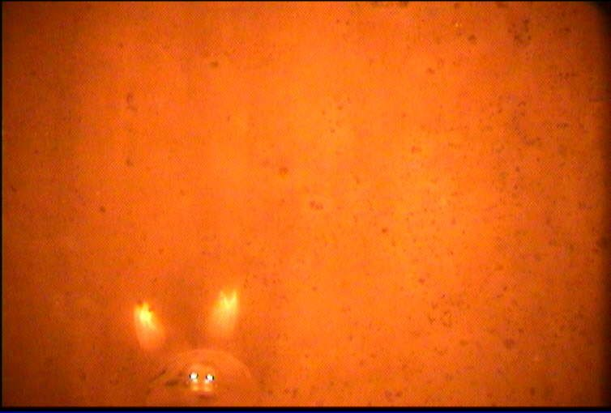
Thanks!
Committee
Evan DeLucia
Carl Bernacchi
Sarah Davis
Andrew Leakey
Committee Emeritus
Mark David
Sanity preservation
The entire DeLucia lab
Anna Locke
Cody Markelz
Jesse Miller
Liz Olney
Matt & Angie Isaacs
Flying Machine Coffee
Funding
Energy Biosciences Institute
DOE/NICCR
Laughnan award
IGB Fellows fund (Woolbright)
All credit not otherwise assigned
Laurel Brehm
TRACED BY
Chris Sligar
ANY ROOTS?
no
NOTES
Ornithorhynchus xylocopa
Notes:
Background image: our Halloween ghost for the day.
There are no roots in this image, and *they* will tell you it’s just reflections from the camera lights in a water droplet.
But Chris wasn’t fooled and he named the specimen what it obviously is: Ornithorhynchus xylocopa… the dreaded “platypus-bee”
Sweet dreams, everyone.

Slide 56
tface

Slide 58
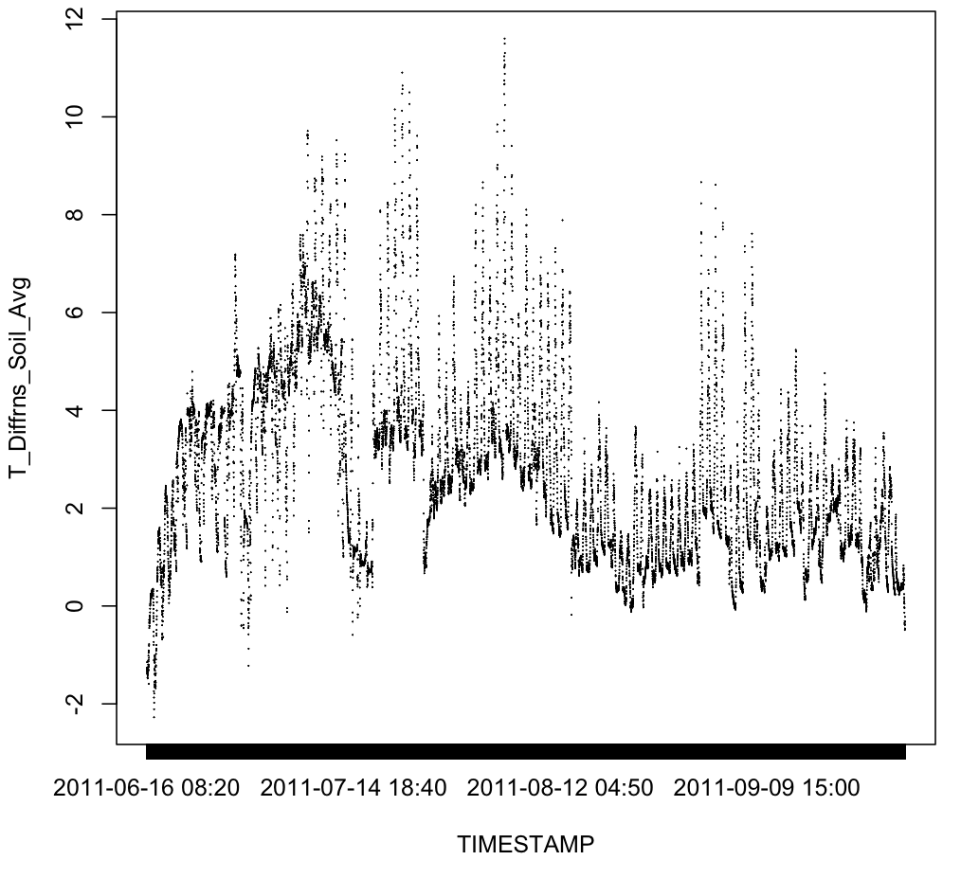
Plot 1 thermocouples, summer 2011

Slide 59
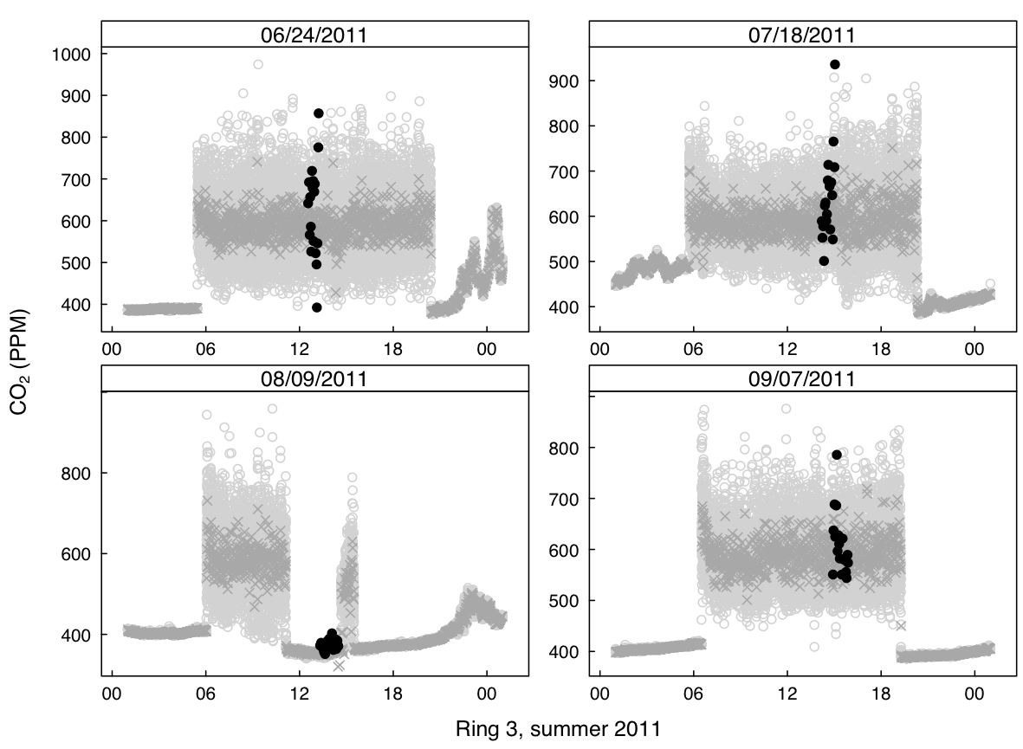
Notes:
Black dots: 8100
Grey dots: control output, 4-second avg
X’s: control output, 1-minute avg

Slide 60
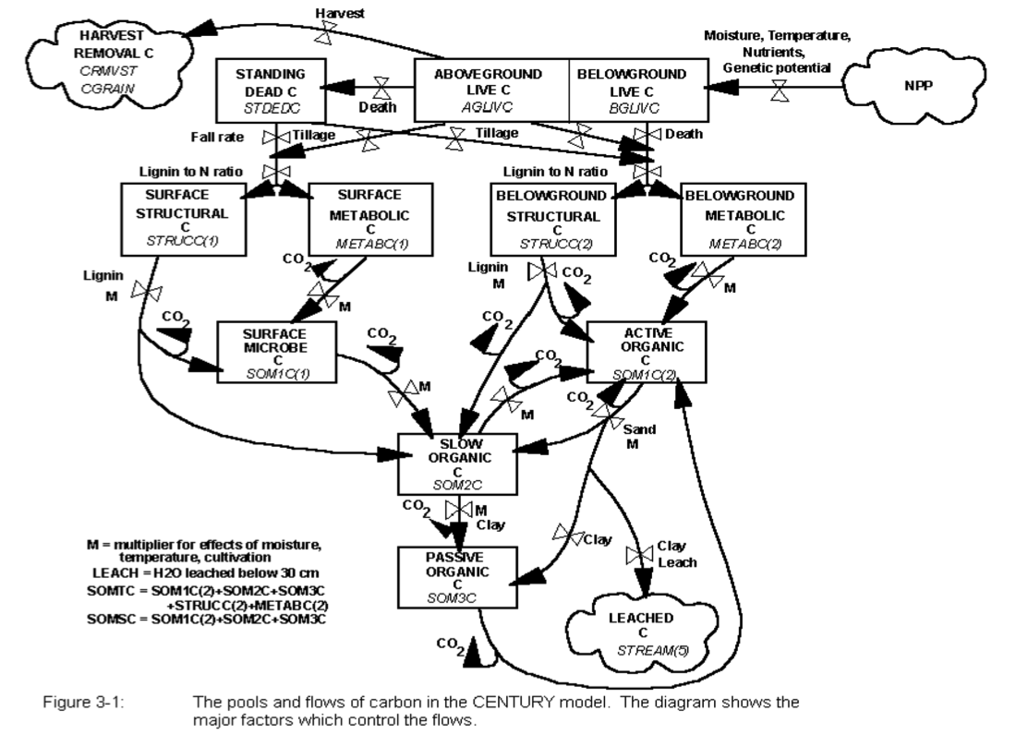

Slide 61
Rhizo

Slide 62
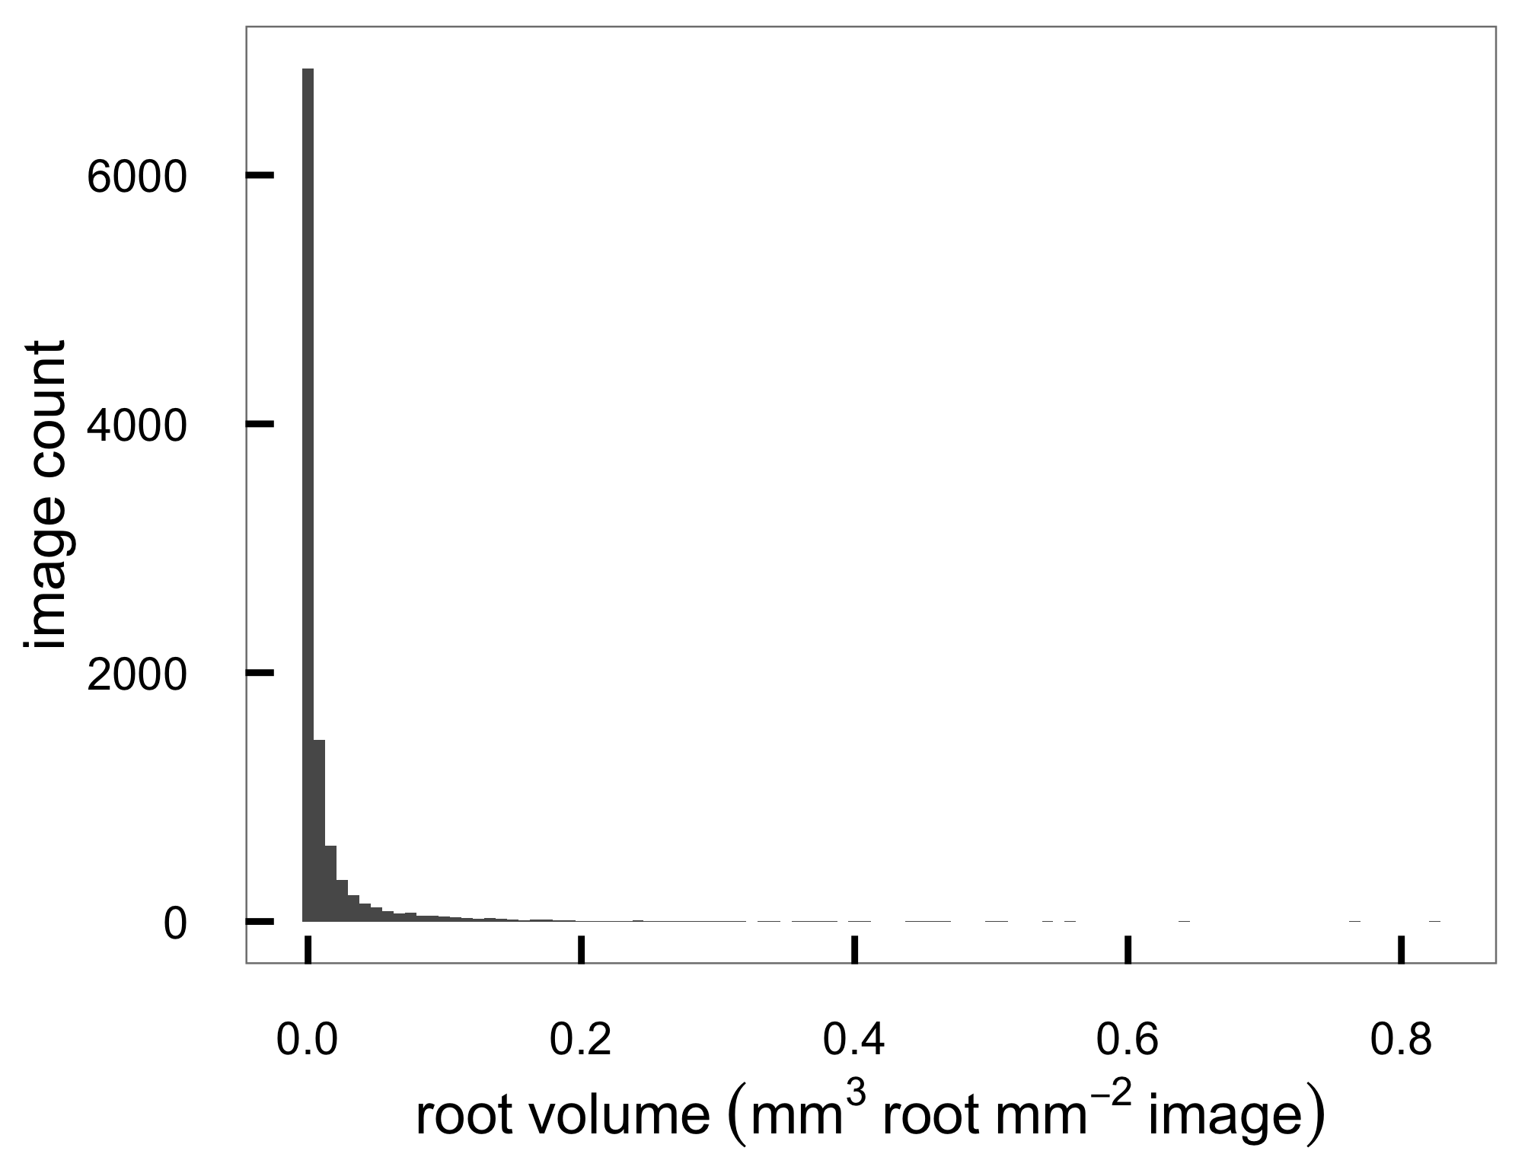
Notes:
…to get data from highly skewed distribution!
So we log-transform it and--

Slide 63
Full model
Notes:
Mixture model is from Derek Sonderegger and Kiona Ogle
This means we need to estimate eight parameters (three alphas, three betas, two sigmas) to fit the model
i.e. solve a hairy high-dimensional integral.
Method: Full Bayesian inference.
Define prior distributions for all parameters
sample from the full joint posterior using Hamiltonian Monte Carlo as implemented in the Stan language.

Slide 64
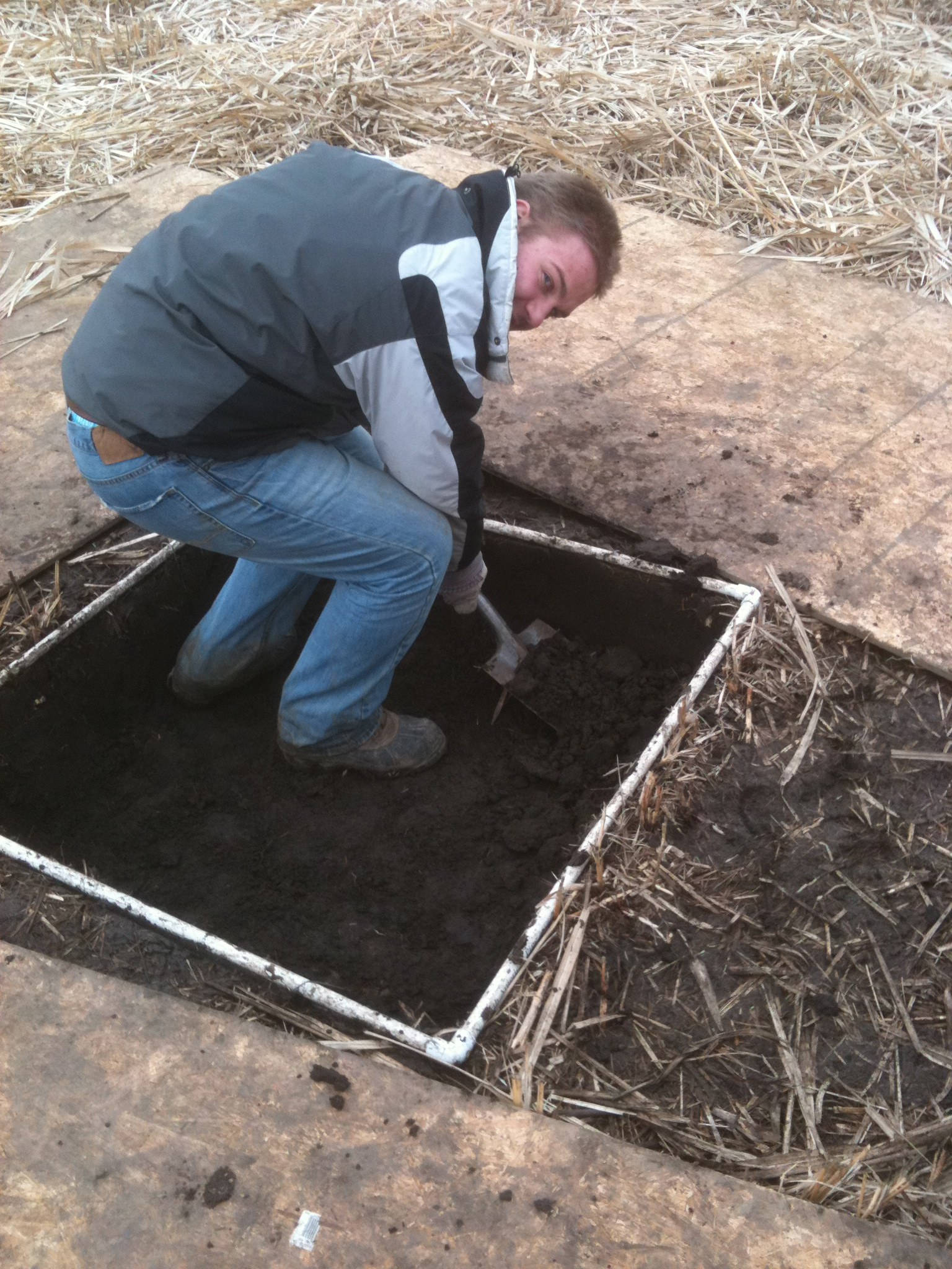
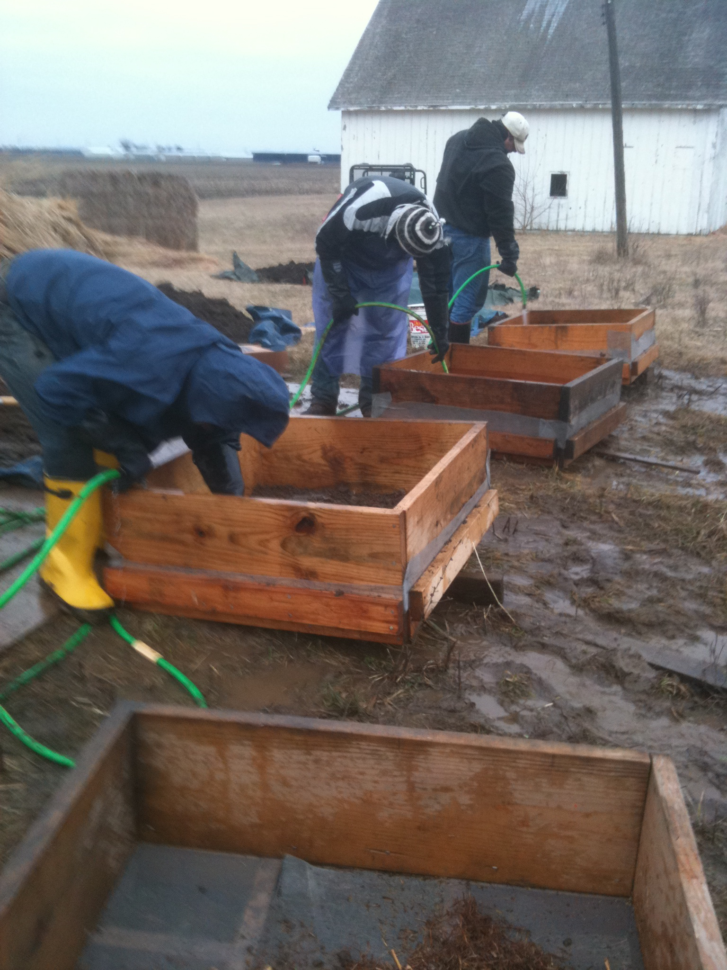
Photos: Mike Masters

Slide 65
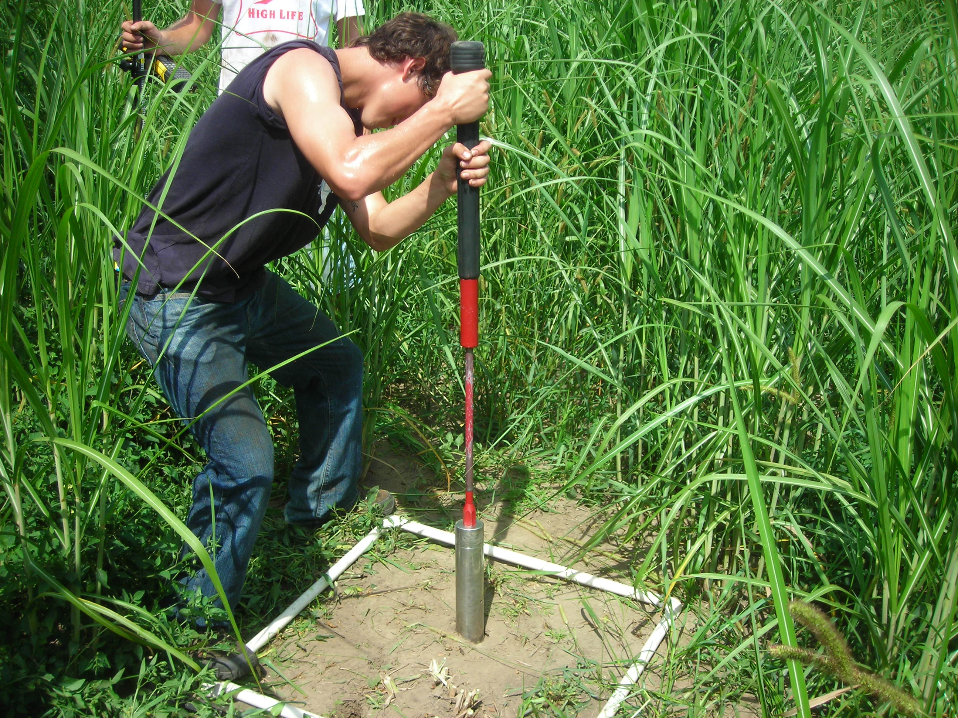
Photo: Mike Masters

Slide 66
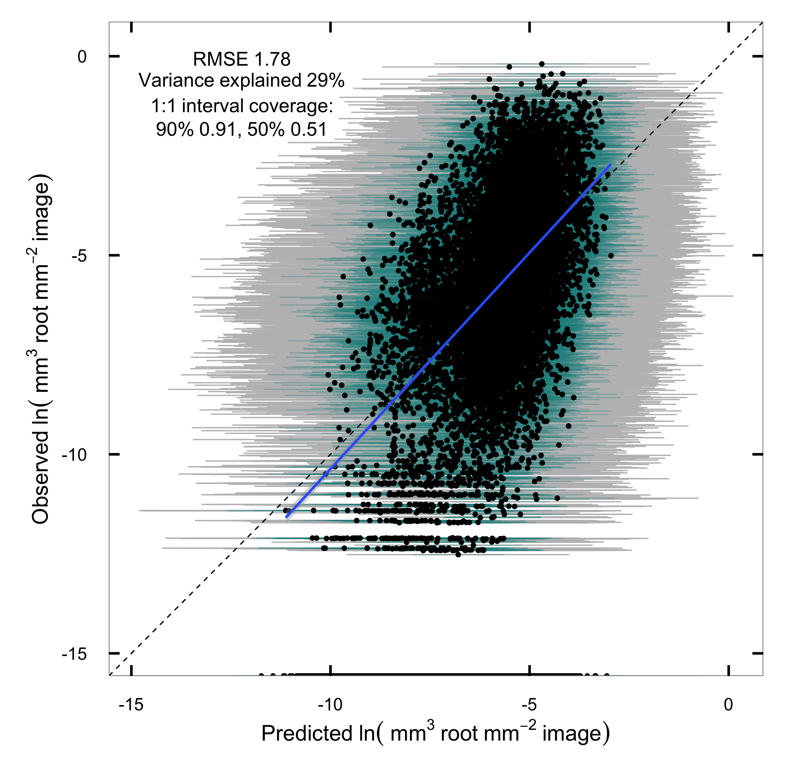
Notes:
Comparing modeled vs predicted root volume of individual tiny images,
We explain about 30% of the variance and no bias.
Interval coverage means our variances are estimated right too

Slide 67

Eoghan Smythe, in prep
Notes:
That great mass of roots is also more recalcitrant.
We buried bags of root litter and sequentially recovered them over the course of a year,
found much less mass lost from switch and Miscanthus than from prairie and corn.
The fast loss from from prairie isn’t a big surprise -- our prarie has a lot of forbs and N-fixers in it and the litter seems to be very high-quality microbe food.

Slide 68
prairie

Slide 69
Notes:
Mock community doesn’t perfectly recover expected community (green dots), but most are present anyway

